Slide 1



Applications’ usage in HPC2N
P. Ojeda, B. B. Brydsö, J. Eriksson

Slide 2
Why do we need HPC?
Scientific codes use loops extensively:
do j=1,N
do i=1,N
do k=1,N
p(i,j) = p(i,j) + v1(i,k)* v2(k,j)
enddo
enddo
enddo
!$omp parallel do private(i,j,k) shared(p,v1,v2) collapse(2)
do j=1,N
do i=1,N
s=0.0d0
do k=1,N
s = s + v1(i,k)* v2(k,j)
enddo
p(i,j) = s
enddo
enddo
!$omp end parallel do
Heavy loops
MD, QM, CFD, …
Parallelized loops

Slide 3

Processes communication
$$T_{p}=\frac{T_{s}}{P}+T_{comm}$$

Slide 4
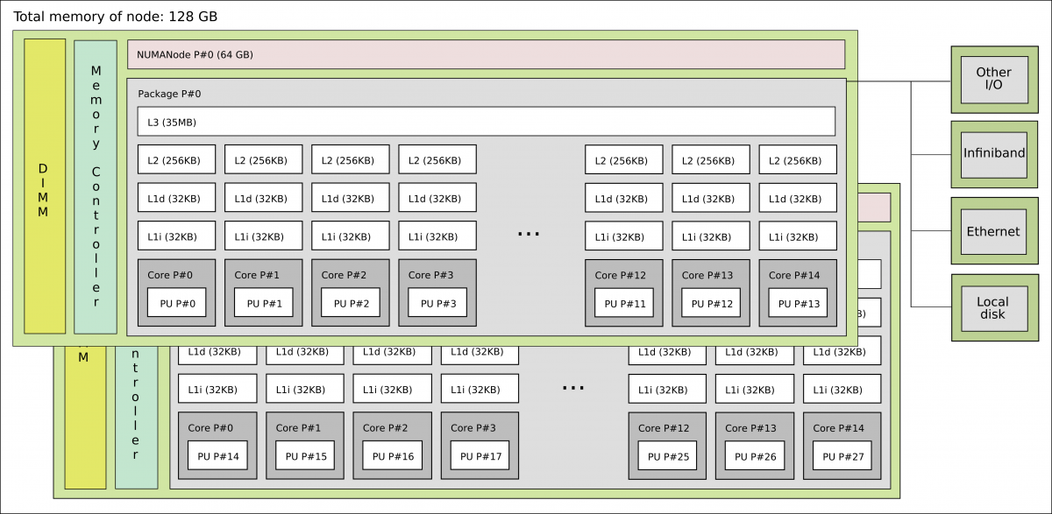
Broadwell node on Kebnekaise

Slide 5
Z(i) = A*X(i) + Y(i) (Vector Op.)

Slide 6
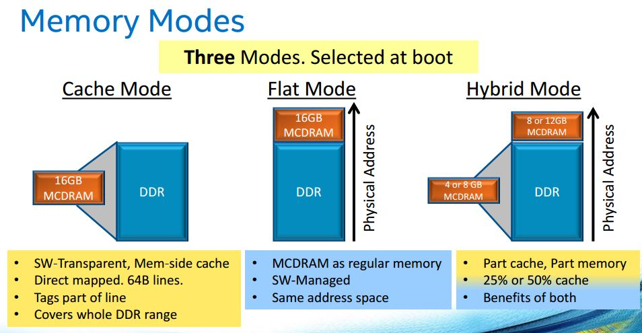
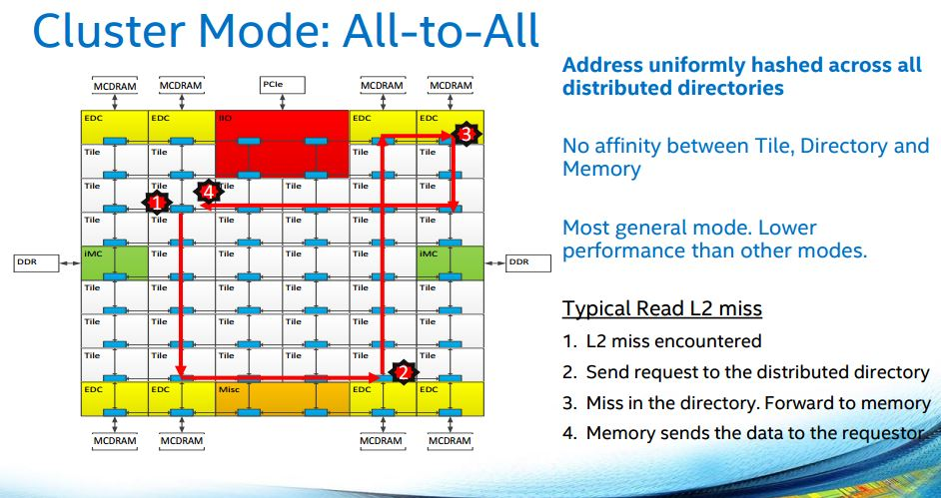
KNL
#SBATCH --constraint=a2a,cache
#SBATCH --gres=hbm:4G
Credits: PRACE Best practice KNL (2017)

Slide 7
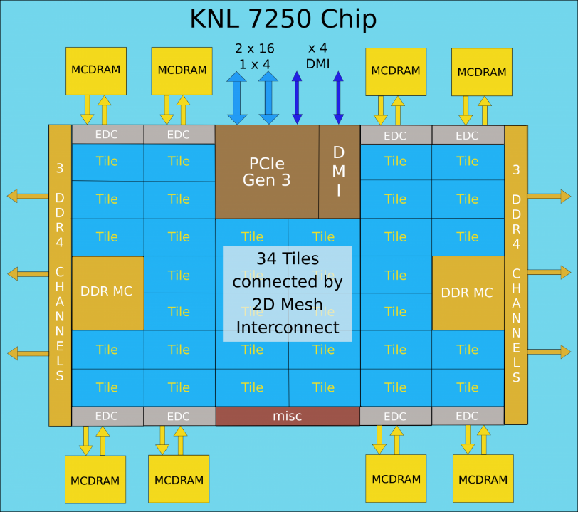
KNL Thread affinity
There are physical 68 cores with 4 hyperthreads on each.
Bind the threads by using OpenMP env. var.
export OMP_NUM_THREADS=4
export OMP_PROC_BIND=spread
export OMP_PLACES=cores
srun -n 68 -c 4 --cpu_bind=cores a_knl.out
Alternatively, use Intel var.
Credits: Intel

Slide 8
KNL Thread affinity
#export OMP_PROC_BIND=spread, close, etc.
#export OMP_PLACES=threads, cores, etc.
export OMP_NUM_THREADS=4
srun -n 16 -c 4 --cpu_bind=cores ./xthi
Hello from rank 0, thread 0, on b-cn1209.hpc2n.umu.se. (core affinity = 0)
Hello from rank 0, thread 1, on b-cn1209.hpc2n.umu.se. (core affinity = 68)
Hello from rank 0, thread 2, on b-cn1209.hpc2n.umu.se. (core affinity = 136)
Hello from rank 0, thread 3, on b-cn1209.hpc2n.umu.se. (core affinity = 204)
Hello from rank 1, thread 0, on b-cn1209.hpc2n.umu.se. (core affinity = 1)
Hello from rank 1, thread 1, on b-cn1209.hpc2n.umu.se. (core affinity = 69)
Hello from rank 1, thread 2, on b-cn1209.hpc2n.umu.se. (core affinity = 137)
Hello from rank 1, thread 3, on b-cn1209.hpc2n.umu.se. (core affinity = 205)

Slide 9
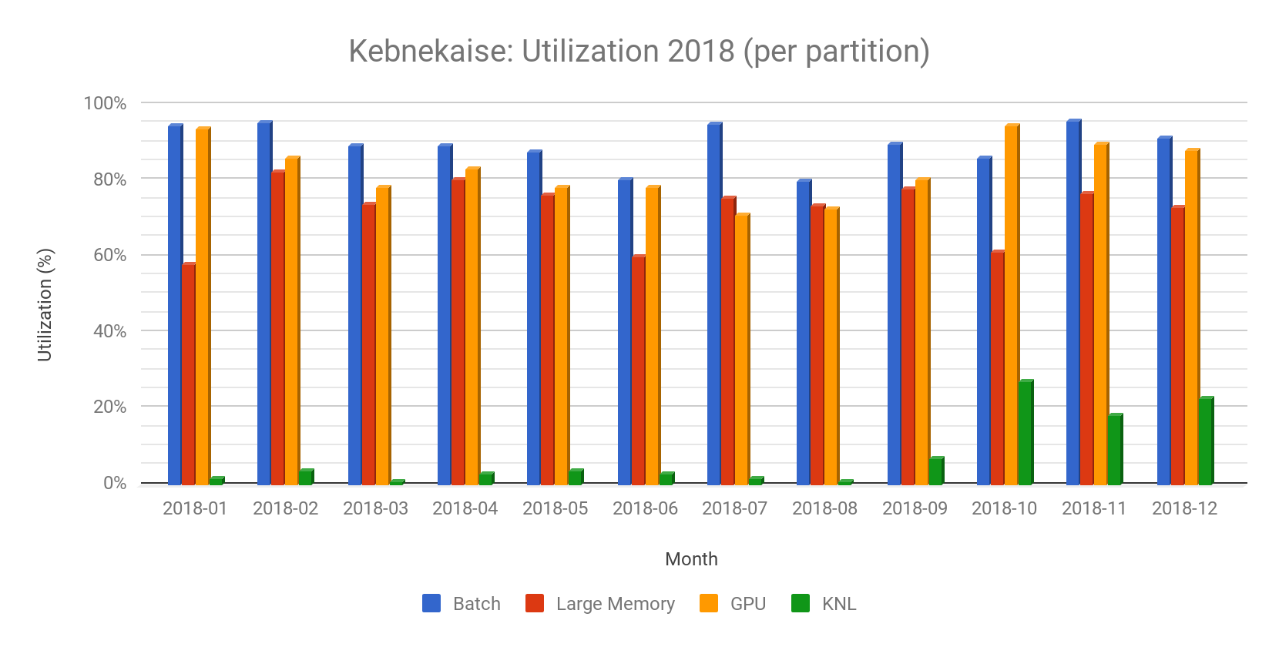
Data/plot from Björn Torkelsson

Slide 10
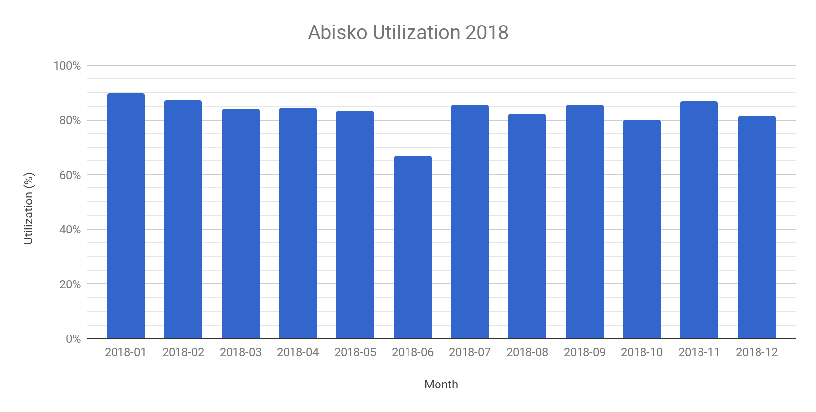
Data/plot from Björn Torkelsson

Slide 11
Tuning your own Applications

Slide 12
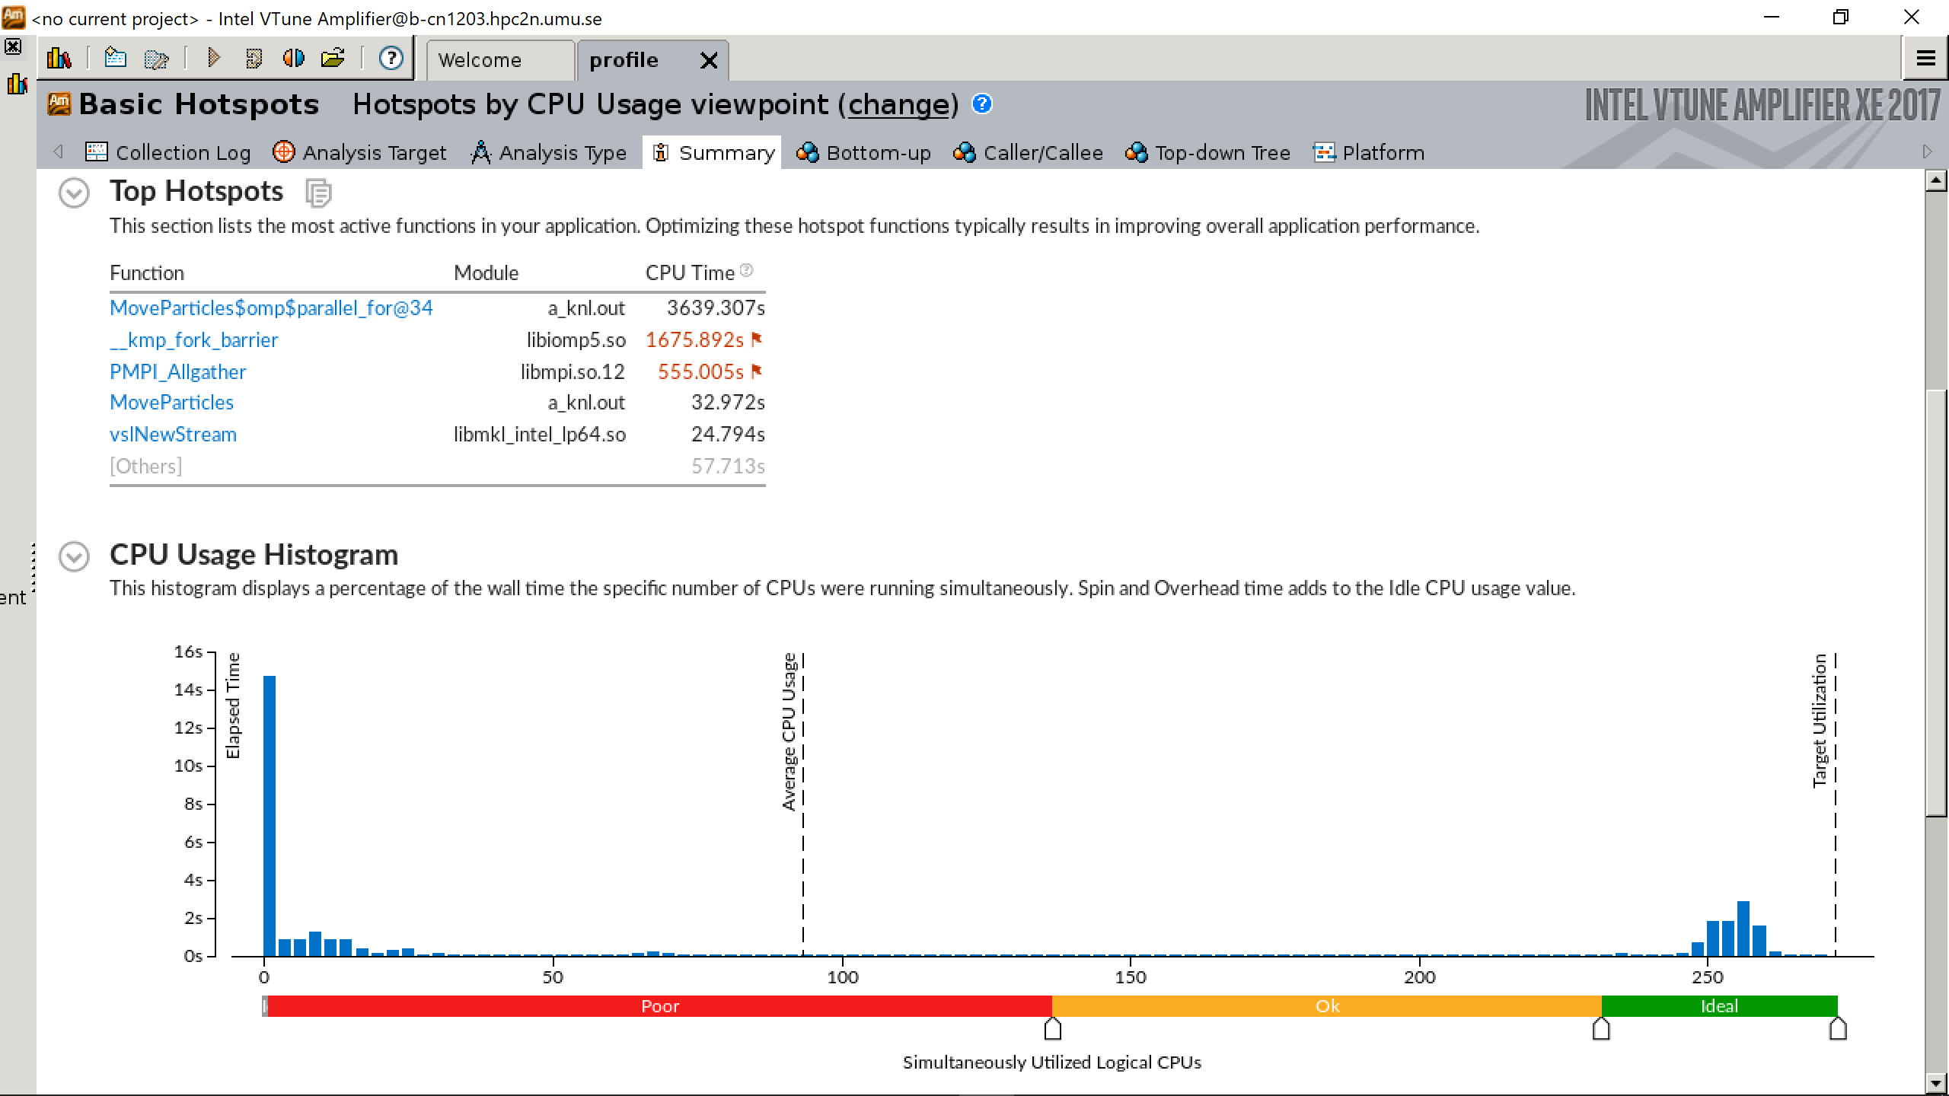

Slide 14
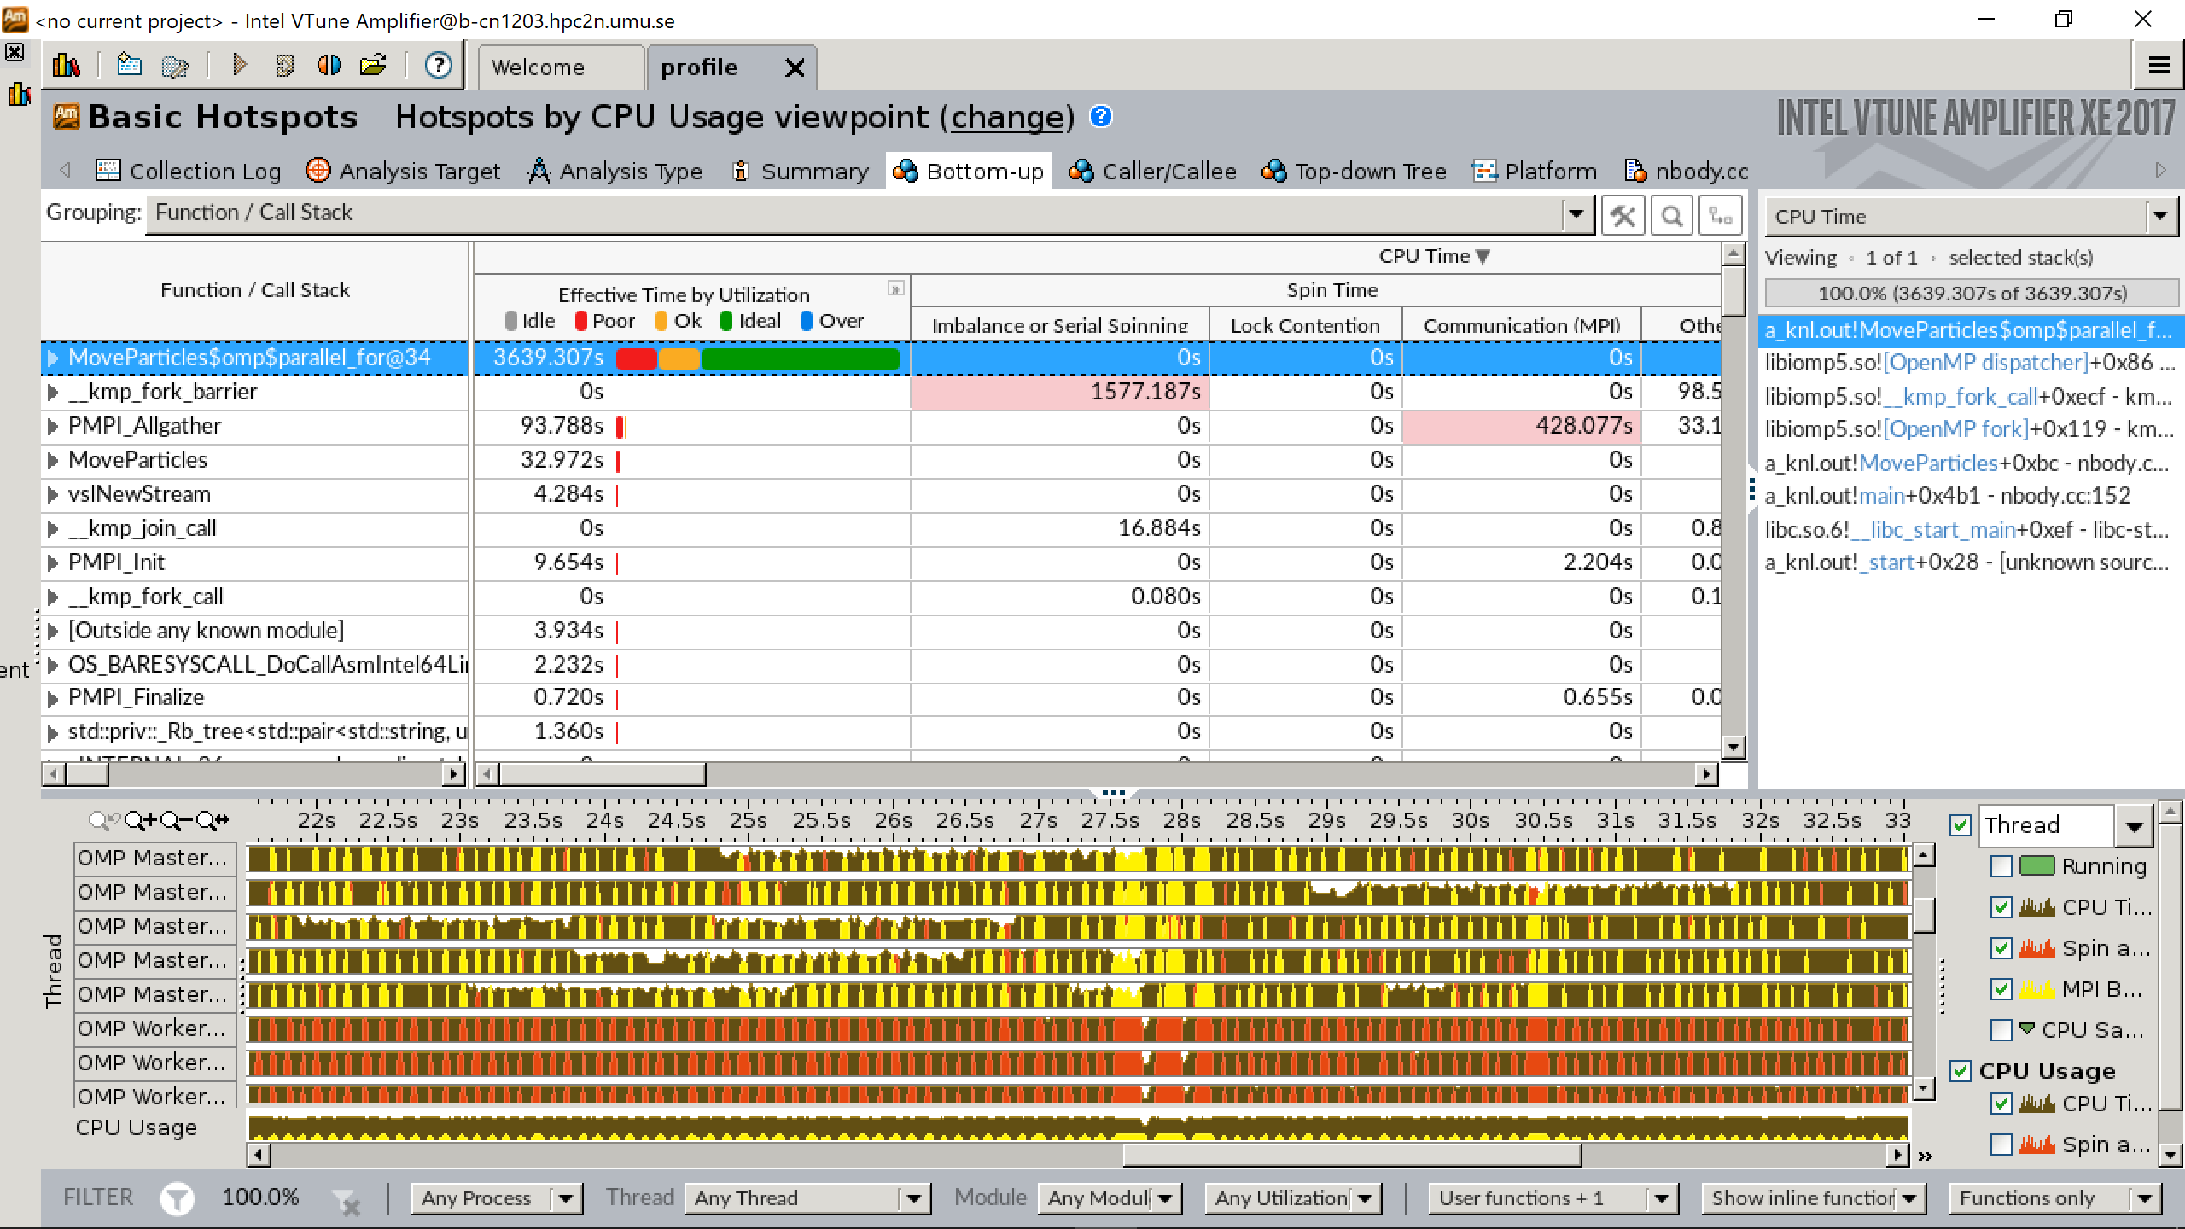

Slide 15
Profiling Tools at HPC2N
Intel Vtune, Intel Inspector
SCALASCA, Score-P, Cube
Extrae/Paraver
Allinea DDT
J. Eriksson, P. Ojeda, T. Ponweiser, T. Steinreicher (2017)

Slide 16
Applications

Slide 17
x1000 core-hour/month. Source: www.snic.se

Slide 18
Data from Magnus Johansson

Slide 19
Data from Magnus Johansson

Slide 20
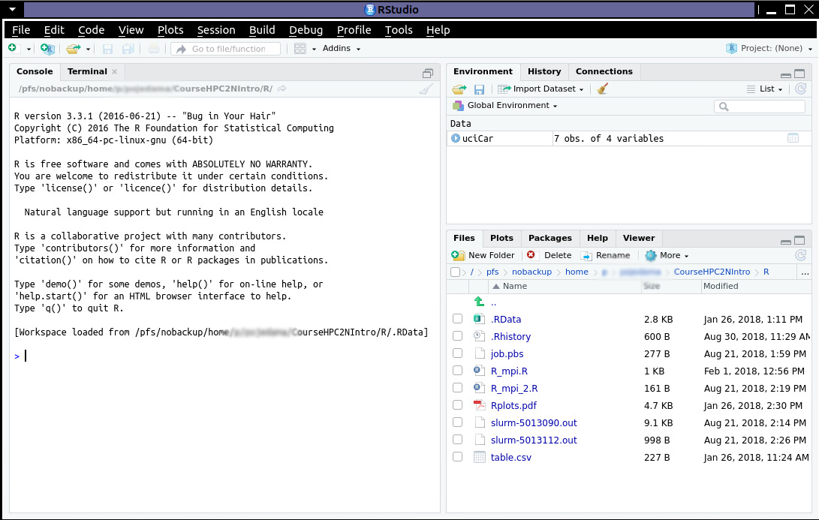
R/Rstudio
$ml icc/2017.1.132-GCC-6.3.0-2.27 impi/2017.1.132 ifort/2017.1.132-GCC-6.3.0-2.27
$ml R/3.3.1
$rstudio
Please use the GUI just for lightweight tasks, otherwise use the batch queues.
Heavy jobs will be cancelled!

Slide 21
R serial job
#!/bin/bash
### SNAC project number, enter your own
#SBATCH -A SNICXXXX-YY-ZZ
# Asking for one core
#SBATCH -n 1
#SBATCH --time=00:10:00
ml icc/2017.1.132-GCC-6.3.0-2.27
ml ifort/2017.1.132-GCC-6.3.0-2.27
ml impi/2017.1.132
ml R/3.3.1
R --no-save --quiet < input.R > Rexample.out
Further information: https://www.hpc2n.umu.se/resources/software/r

Slide 22
R parallel job (Rmpi)
File: Rmpi.R
library("Rmpi")
mpi.spawn.Rslaves(nslaves=5)
x <- c(10,20,30,40,50)
mpi.apply(x,runif)
# Close down the MPI processes and quit R
mpi.close.Rslaves()
mpi.finalize()
#!/bin/bash
#SBATCH -A project_ID
#Asking for 10 min.
#SBATCH -t 00:10:00
#SBATCH -N 1
#SBATCH -n 6
export OMPI_MCA_mpi_warn_on_fork=0
ml GCC/6.4.0-2.28 OpenMPI/2.1.2
ml R/3.4.4-X11-20180131
R -q --slave -f Rmpi.R
Further information: https://www.hpc2n.umu.se/resources/software/r

Slide 23
R parallel job (doParallel)
doParallel_ML.R
#!/bin/bash
#SBATCH -A project_ID
#Asking for 10 min.
#SBATCH -t 00:10:00
##SBATCH -N 1
#SBATCH -n 8
##SBATCH --exclusive
ml GCC/6.4.0-2.28 OpenMPI/2.1.2
ml R/3.4.4-X11-20180131
R -q --slave -f doParallel_ML.R
library(doParallel)
registerDoParallel(cores=8)
getDoParWorkers()
library(caret)
library(MASS)
library(klaR)
library(nnet)
library(e1071)
library(rpart)
Further information: https://www.hpc2n.umu.se/resources/software/r

Slide 24
R parallel job (doParallel)
doParallel_ML.R
#!/bin/bash
#SBATCH -A project_ID
#Asking for 10 min.
#SBATCH -t 00:10:00
##SBATCH -N 1
#SBATCH -n 8
##SBATCH --exclusive
ml GCC/6.4.0-2.28 OpenMPI/2.1.2
ml R/3.4.4-X11-20180131
R -q --slave -f doParallel_ML.R
#Serial mode
sr <- foreach(1:runs, .combine = rbind) %do% evaluation()
#Parallel mode
pr <- foreach(1:runs, .combine = rbind) %dopar% evaluation()
Further information: https://www.hpc2n.umu.se/resources/software/r

Slide 25
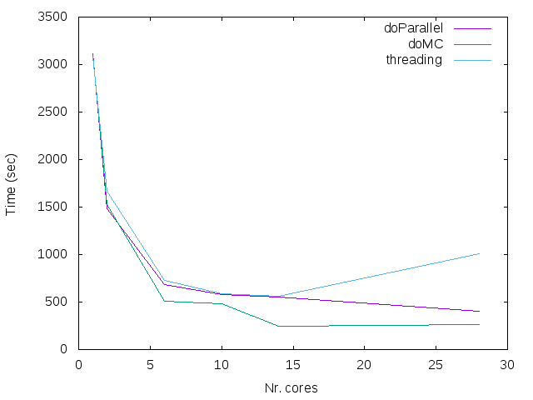
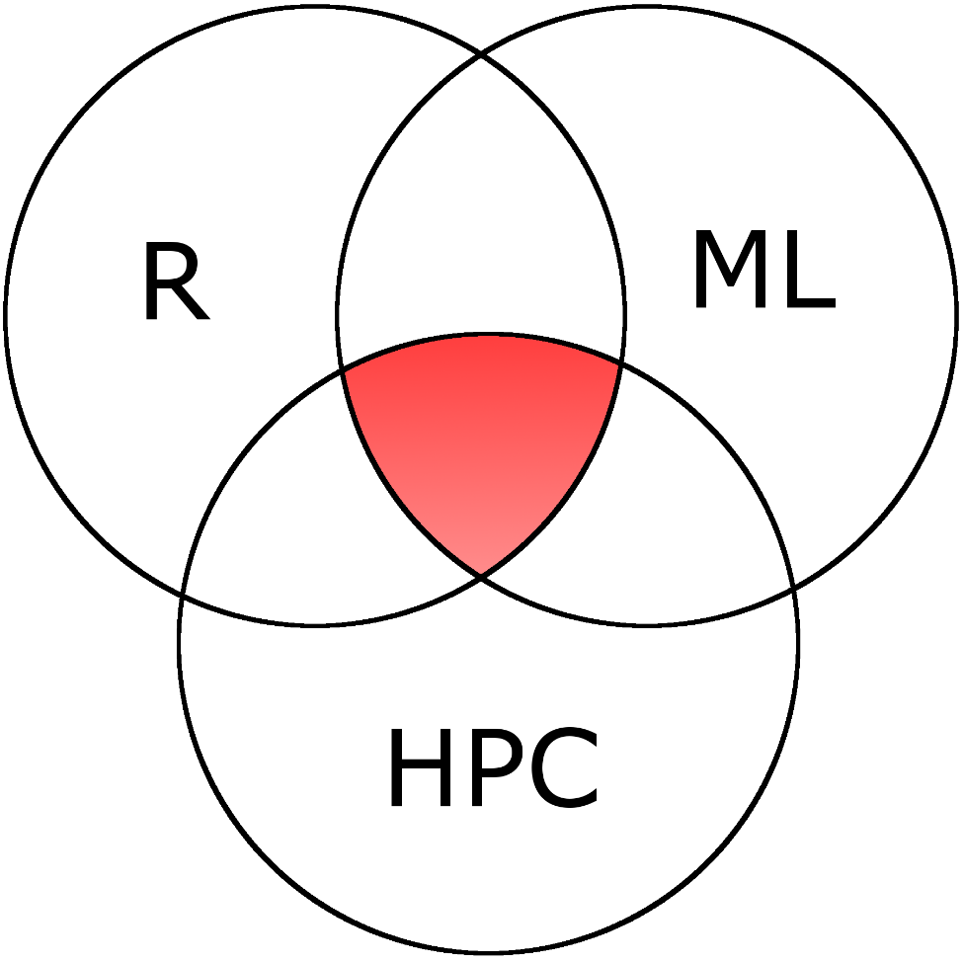
R machine learning
Example: Boosted classification model using “xgboost” (7 tunning parameters). Using R package on Kebnekaise (details: http://appliedpredictivemodeling.com/blog/2018/1/17/parallel-processing).

Slide 26
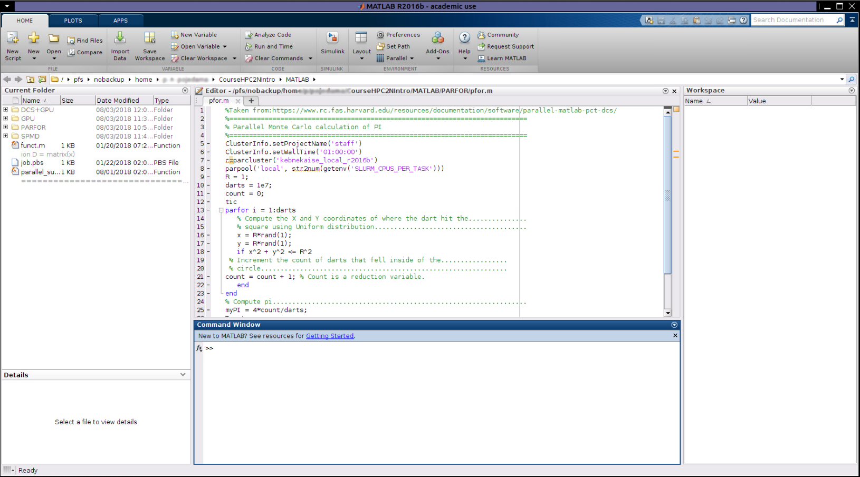
MATLAB
One needs to configure MATLAB the first time one uses it:
*MATLAB 2016b (https://www.hpc2n.umu.se/resources/software/config-matlab-2016b)
*MATLAB 2018b and later (https://www.hpc2n.umu.se/resources/software/configure-matlab-2018)
Please use the GUI just for lightweight tasks, otherwise use the batch queues.
Heavy jobs will be cancelled!
$ml MATLAB/2016b
Further information: https://www.hpc2n.umu.se/resources/software/matlab

Slide 27
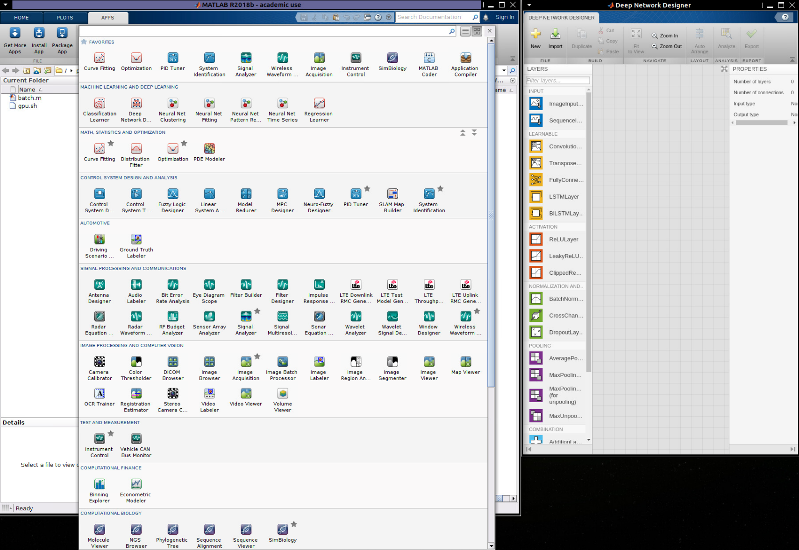
MATLAB
$ml MATLAB/2018b
Includes improved tools for Machine Learning and Deep Learning
Further information: https://www.hpc2n.umu.se/resources/software/matlab

Slide 28
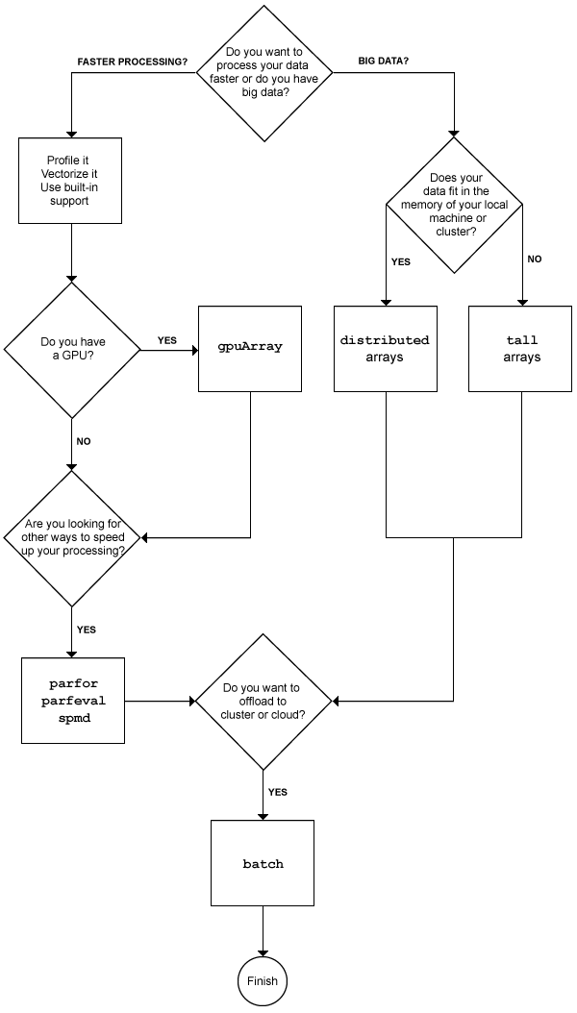
Parallel computing tools in MATLAB
Source: https://se.mathworks.com/help/parallel-computing/choosing-a-parallel-computing-solution.html

Slide 29
MATLAB
Parallel Computing Toolbox (PCT)
- Parfor loops
- Single Program Multiple Data, Labs are used to solve a task
Distributed Computing Server (DCS)

Slide 30
Serial job
File name: funct.m
function D
format long
A1 = rand(10000,10000);
tic;
B1 = fft(A1);
time1 = toc;
filename = 'log.out';
mid=fopen(filename,'w');
fprintf(mid,'Time = %16.12f\n',time1);
fclose(mid);
#!/bin/bash
#SBATCH -A project_ID
#Asking for 10 min.
#SBATCH -t 00:10:00
#SBATCH -n 1
#SBATCH -p batch
#Load modules necessary for running MATLAB
ml MATLAB/2016b
srun matlab -nodisplay -singleCompThread -r "funct;exit" > out.log
exit 0

Slide 31
Parfor
File name: pfor.m
parpool('local', str2num(getenv('SLURM_CPUS_PER_TASK')))
parfor i = 1:darts
x = rand(1);
y = rand(1);
if x^2 + y^2 <= R^2
count = count + 1; % reduction variable.
end
end
Batch script:
#SBATCH -c 4
#SBATCH -p batch
#Load modules necessary for running MATLAB
ml MATLAB/2016b
srun matlab –nodisplay -r "pfor"
Timing
Nr. Workers Time(sec)
1 26.43
2 17.17
3 11.82
7.71
28 1.82
Source: https://www.rc.fas.harvard.edu/resources/documentation/software/parallel-matlab-pct-dcs/

Slide 32
SPMD
File: spmdex.m
parpool('local', str2num(getenv('SLURM_CPUS_PER_TASK')))
% The expression that we wish to integrate:
f = @(x) 4./(1 + x.^2);
spmd
% Choose a range over which to integrate based on my unique index:
range_start = (labindex - 1) / numlabs;
range_end = labindex / numlabs;
% Calculate my portion of the overall integral
my_integral = quadl( f, range_start, range_end );
% Aggregate the result by adding together each value of ?my_integral?
total_integral = gplus( my_integral );
end
total_int = total_integral{1};
fprintf('The computed value of pi is %8.7f.n',total_int);
delete(gcp);
#!/bin/bash
#SBATCH -A staff
#Asking for 10 min.
#SBATCH -t 00:10:00
#SBATCH -c 4
#SBATCH -p batch
#Load modules necessary for MATLAB
ml MATLAB/2016b
srun matlab -nodisplay -r "spmdex" > out.log
Source: https://se.mathworks.com/company/newsletters/articles/solving-large-scale-linear-algebra-problems-using-spmd-and-distributed-arrays.html

Slide 33
MATLAB+GPU
File: parallelex.m
On the MATLAB GUI:
function S = parallel(x)
format long
A1 = rand(10000,10000);
tic;
B1 = fft(A1);
time1 = toc;
A2 = gpuArray(A1);
tic;
B2 = fft(A2);
time2 = toc;
speedUp1 = time1/time2;
end
c = parcluster;
ClusterInfo.setProjectName('staff');
ClusterInfo.setWallTime('00:10:00');
% Tell the scheduler that you want to use the GPUs
ClusterInfo.setUseGpu(true)
% number of GPUs per node to use
ClusterInfo.setGpusPerNode(2)
ClusterInfo.setUserDefinedOptions('--gres=gpu:k80:2,mps')
%gpuDevice
j = c.batch(@parallelex, 1, {1}, 'pool', 2);

Slide 34
MATLAB+GPU
File: parallelex.m
Batch file: gpu.sh
function S = parallel(x)
format long
A1 = rand(10000,10000);
tic;
B1 = fft(A1);
time1 = toc;
A2 = gpuArray(A1);
tic;
B2 = fft(A2);
time2 = toc;
speedUp1 = time1/time2;
end
#!/bin/bash
#SBATCH -A staff
#Asking for 10 min.
#SBATCH -t 00:10:00
#SBATCH -N 1
#SBATCH -n 1
#SBATCH --gres=gpu:k80:2
#SBATCH -p batch
#SBATCH --exclusive
#Load modules necessary for running MATLAB
ml MATLAB/2016b
srun matlab -nodisplay -singleCompThread -r "parallelex" > test_parallel.log

Slide 35
MD Codes

Slide 36
Benchmark
Solvated protein
158945 atoms
1.2 nm cutoff radius
1 fs time step
PME for electrostatics
http://www.charmm-gui.org/

Slide 37
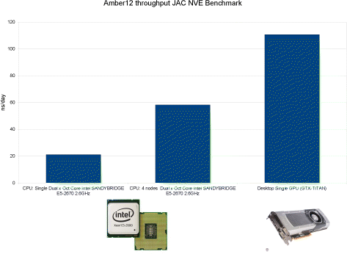
Amber
JCTC, 9, 3878 (2013)
Collection of independent routines
It uses Sander/PMEMD for solving the Newton’s equations
It offers a robust set of analysis tools
module load icc/2017.1.132-GCC-5.4.0-2.26 CUDA/8.0.44 impi/2017.1.132
module load ifort/2017.1.132-GCC-5.4.0-2.26 CUDA/8.0.44
ml Amber/16-AmberTools-16-patchlevel-20-7-hpc2n
srun pmemd.MPI -O -i input.mdin
srun pmemd.cuda.MPI -O –I input.mdin

Slide 38
AMBER Tools
For setting up a simulation (initial structure, solvation, ions, …):
Load the modules:
$ml icc/2017.4.196-GCC-6.4.0-2.28 ifort/2017.4.196-GCC-6.4.0-2.28 impi/2017.3.196
$ml Amber/16-AmberTools-17-patchlevel-8-12
On the command line:
$tleap, antechamber, cpptraj, …

Slide 39
AMBER

Slide 40
AMBER
On Kebnekaise, best performance is achieved with 4 MPIs/Node and using 2 GPU cards
Notice that, the remaining CPUs are not used.

Slide 41
Comment on the CUDA version
AMBER-CUDA does all computations on the GPUs. Thus, the remaining cores remain idle. One can use those cores by launching an additional MPI simulation:
#!/bin/bash
#SBATCH -N 1
#SBATCH -n 28
#SBATCH --gres=gpu:k80:2
#Load the AMBER-CUDA version
export init="step3_charmm2amber"
export pstep="step4.0_minimization"
export istep="step4.1_equilibration"
mpirun -np 4 pmemd.cuda.MPI -O -i ${istep}.mdin -p ${init}.parm7 -c ${pstep}.rst7 -o ${istep}.mdout -r ${istep}.rst7 -inf ${istep}.mdinfo -ref ${init}.rst7 -x ${istep}.nc &
export istep2="step4.1_equilibration_parall"
mpirun -np 24 pmemd.MPI -O -i ${istep2}.mdin -p ${init}.parm7 -c ${pstep}.rst7 -o ${istep2}.mdout -r ${istep2}.rst7 -inf ${istep2}.mdinfo -ref ${init}.rst7 -x ${istep2}.nc &
wait

Slide 42
NAMD
Based on charm++ communication protocol
It is object-oriented
Versions: single node, multi-node, GPU, and KNL
Highly scalable
JCC, 151, 283 (1999)

Slide 43
NAMD (SMP)
#!/bin/bash
#SBATCH -A staff
#Asking for 10 min.
#SBATCH -t 00:50:00
#Number of nodes
#SBATCH -N 1
#Ask for 28 processes
#SBATCH -n 28
#SBATCH --exclusive
#Load modules necessary for running NAMD
module add icc/2017.1.132-GCC-6.3.0-2.27 impi/2017.1.132
module add NAMD/2.12-nompi
#Execute NAMD
namd2 +p 28 +setcpuaffinity step4_equilibration.inp > output_smp.dat

Slide 44
NAMD (GPU) (single node)
#!/bin/bash
#SBATCH -A staff
#SBATCH -t 00:50:00
#SBATCH -N 1
#SBATCH -n 28
#SBATCH –exclusive
#Ask for 2 GPU cards
#SBATCH --gres=gpu:k80:2
#Load modules necessary for running NAMD
module add GCC/5.4.0-2.26 CUDA/8.0.61_375.26 OpenMPI/2.0.2
module add NAMD/2.12-nompi
#Execute NAMD
namd2 +p 28 +setcpuaffinity step4_equilibration.inp > output_smp.dat

Slide 45
NAMD
Colvars module for free energy calculations can be run on GPUs.

Slide 46
NAMD
Use the +setcpuaffinity flag for a 10% speedup

Slide 47
NAMD
With the new Volta GPU cards one can speed up the simulation by 1.66x

Slide 48
GROMACS
#SBATCH -n 4
#SBATCH -c 7
# Asking for 2 GPUs
#SBATCH --gres=gpu:k80:2
#SBATCH -p batch
ml GCC/5.4.0-2.26
ml CUDA/8.0.44
ml OpenMPI/2.0.1
ml GROMACS/2016-hybrid
if [ -n "$SLURM_CPUS_PER_TASK" ]; then
mdargs="-ntomp $SLURM_CPUS_PER_TASK"
else
mdargs="-ntomp 1"
fi
srun -n $SLURM_NTASKS gmx_mpi mdrun $mdargs -npme 0 -dlb yes -v -deffnm step4.1_equilibration
GROMACS recognizes the number of available GPU cards

Slide 49
gmx tune_pme
Individual timings for input file 0 (npt_bench00.tpr):
PME ranks Gcycles ns/day PME/f Remark
0 4355.019 57.776 - OK.
0 4547.105 55.335 - OK.
0 4289.420 58.659 - OK.
-1( 0) 4455.791 56.469 - OK.
-1( 0) 4440.157 56.668 - OK.
-1( 0) 4275.551 58.850 - OK.
Tuning took 7.7 minutes.
------------------------------------------------------------
Summary of successful runs:
Line tpr PME ranks Gcycles Av. Std.dev. ns/day PME/f DD grid
0 0 0 4397.181 133.917 57.257 - 4 1 1
1 0 -1( 0) 4390.500 99.855 57.329 - 4 1 1
------------------------------------------------------------
Best performance was achieved with the automatic number of PME ranks (see line 1)
Please use this command line to launch the simulation:
mpirun -np 4 gmx_mpi mdrun -npme -1 -s npt.tpr -ntomp 7 -dlb yes

Slide 50
GROMACS

Slide 51
GROMACS KNL
#!/bin/bash
#SBATCH -A project_ID
#SBATCH -t 00:50:00
#SBATCH -N 1
#SBATCH -n 68
#SBATCH -p knl
#SBATCH --constraint=cache,quad
#SBATCH --exclusive
ml GCC/7.3.0-2.30 OpenMPI/3.1.1
ml GROMACS/2018.3
export OMP_NUM_THREADS=2
gmx mdrun -ntmpi 68 -npme 18 -ntomp 2 -pin on -pinoffset 0 -pinstride 2 -dlb auto -v -deffnm step4.1_equilibration

Slide 52
GROMACS KNL
Login to kebnekaise-knl.hpc2n.umu.se and submit your script from there
KNL queue is most of the time available compared to GPU one

Slide 53
GROMACS

Slide 54
GROMACS
PLUMED, threaded MPI version is not supported.
Instead of:
gmx mdrun –ntmpi X
Use:
mpirun gmx_mpi …
New offloading features starting from 2018 version:
https://www.hpc2n.umu.se/events/courses/md-course-spring-2019

Slide 55
LAMMPS (MPI)
#!/bin/bash
#SBATCH -A staff
#Asking for 10 min.
#SBATCH -t 02:10:00
#Number of nodes
#SBATCH -N 1
#Ask for 28 processes
#SBATCH -n 28
#SBATCH --exclusive
#Load modules necessary for running LAMMPS
module load icc/2017.1.132-GCC-6.3.0-2.27 ifort/2017.1.132-GCC-6.3.0-2.27 impi/2017.1.132
module load LAMMPS/31Mar17
#Execute LAMMPS
srun lmp_intel_cpu -in step4.1_equilibration.inp

Slide 56
LAMMPS (OpenMP)
#!/bin/bash
#SBATCH -A staff
#Asking for 10 min.
#SBATCH -t 02:10:00
#Number of nodes
#SBATCH -N 1
#Ask for 28 processes
#SBATCH -n 14
#SBATCH -c 2
#SBATCH --exclusive
#Load modules necessary for running LAMMPS
module load icc/2017.1.132-GCC-6.3.0-2.27 ifort/2017.1.132-GCC-6.3.0-2.27 impi/2017.1.132
module load LAMMPS/31Mar17
export OMP_NUM_THREADS=2
#Execute LAMMPS
srun lmp_intel_cpu -in step4.1_equilibration.inp

Slide 57
LAMMPS - OpenMM - CHARMM

Slide 58
Scratch directory
If the program writes frequently data, you can get an additional speed up by using the local scratch directory:
rm -rf /scratch/test
export parent=/pfs/nobackup/home/u/username/benchmarks/
mkdir /scratch/test
rsync -avzh $parent/ /scratch/test/
cd /scratch/test
namd2 +p 28 +setcpuaffinity input.inp > output.dat
cd $parent
rsync -avzh /scratch/test/ $parent/
rm -rf /scratch/test
~10-15% speedup
Abisko (all nodes): 352 GB
Kebnekaise, standard nodes: 171 GB
Kebnekaise, GPU nodes: 171 GB
Kebnekaise, Largemem nodes: 352 GB (a few have 391 GB)

Slide 59
Suggestions
Check if the software version you are trying is MPI (-n), OpenMP (-c), or hybrid (-n -c). Also, if you are using a GPU version.
Is your simulation scaling properly?
Is the cutoff radius for long-range interactions appropriate? PME (gmx tune_pme for GROMACS)?

Slide 60
Tensorflow
#!/usr/share/python
import tensorflow as tf
hello = tf.constant('Hello, TensorFlow!')
sess = tf.Session()
print(sess.run(hello))
name: Tesla K80
major: 3 minor: 7 memoryClockRate (GHz) 0.8235
pciBusID 0000:0f:00.0
Total memory: 11.17GiB
Free memory: 11.10GiB
2017-12-05 17:13:03.555397: W
Found device 1 with properties:
name: Tesla K80
>>> print(sess.run(hello))
b'Hello, TensorFlow!'
#!/bin/bash
#SBATCH -A staff
#SBATCH -t 00:50:00
#SBATCH -N 1
#SBATCH --exclusive
#SBATCH --gres=gpu:k80:2
ml icc/2017.1.132-GCC-5.4.0-2.26
ml ifort/2017.1.132-GCC-5.4.0-2.26
mlCUDA/8.0.44 impi/2017.1.132
ml Python/3.6.1
ml Tensorflow/1.3.0-Python-3.6.1
python tensor.py

Slide 61
Tensorflow
#!/usr/share/python
import tensorflow as tf
#Parameters
W = tf.Variable([.3],tf.float32)
b = tf.Variable([-.3],tf.float32)
#Input and output
x = tf.placeholder(tf.float32)
linear_model = W*x+b
y = tf.placeholder(tf.float32)
#Loss
square_delta = tf.square(linear_model-y)
loss = tf.reduce_sum(square_delta)
#Optimize
optimizer = tf.train.GradientDescentOptimizer(0.01)
train = optimizer.minimize(loss)
init = tf.global_variables_initializer()
sess = tf.Session()
sess.run(init)
for i in range (1000):
sess.run(train,{x:[1,2,3,4],y:[0,-1,-2,-3]})
print(sess.run([W,b]))
Computing the loss
name: Quadro K6000
major: 3 minor: 5 memoryClockRate (GHz) 0.9015
pciBusID 0000:06:00.0
Total memory: 11.92GiB
Free memory: 11.82GiB
Creating TensorFlow device (/gpu:0) -> (device: 0, name: Quadro K6000, pci bus id: 0000:06:00.0)
[array([-0.9999969], dtype=float32), array([ 0.99999082], dtype=float32)]

Slide 62
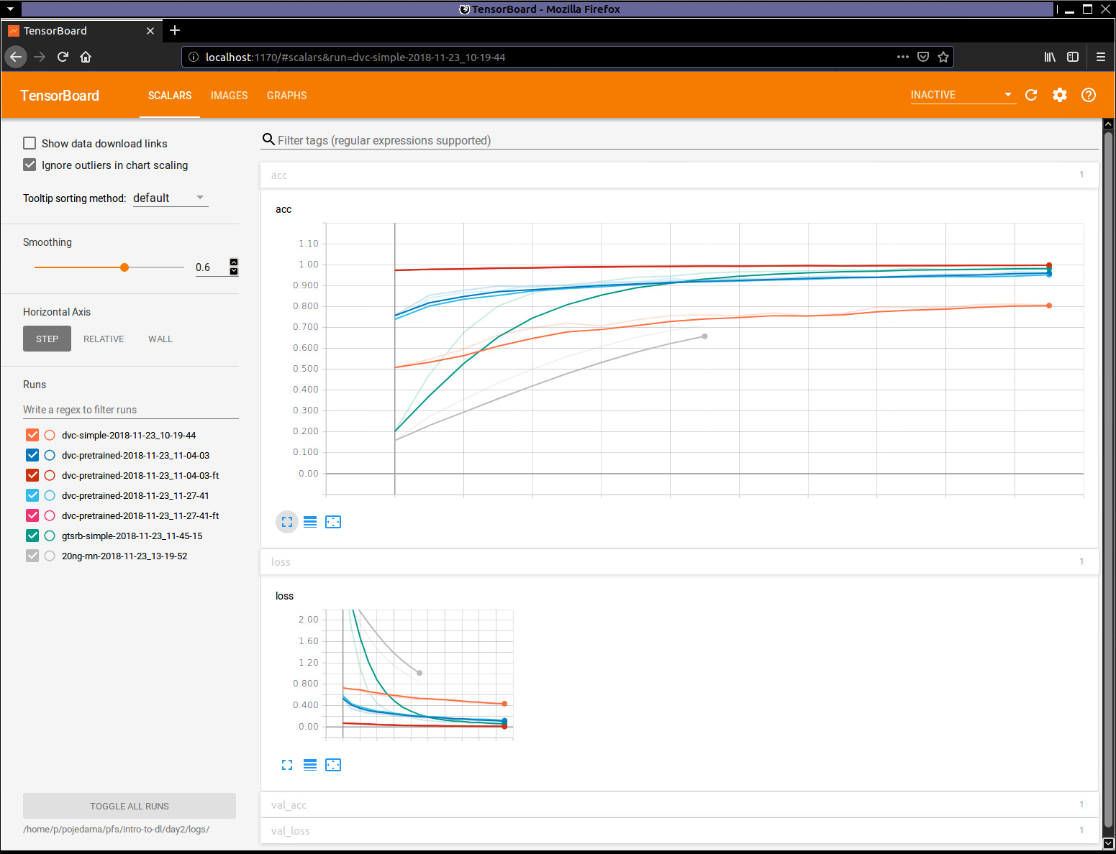
Tensorflow+Tensorboard
module load GCC/7.3.0-2.30 CUDA/9.2.88 OpenMPI/3.1.1 #On the command line execute these instructions
module load TensorFlow/1.10.1-Python-2.7.15 Keras/2.2.2-Python-2.7.15
tensorboard --logdir=/home/p/<path-to-directory>/logs --port=1170
To monitor the behavior of you jobs open a web browser and type:
localhost:1170

Slide 63
GAUSSIAN+GPU
Integral=(FineGrid,Acc2E=10) Constants=2006

Slide 64
VASP
Batch script:
#SBATCH -c 10 (number of cores per task)
#SBATCH -n 1 (number of tasks)
ml ifort/2017.1.132-GCC-6.3.0-2.27 OpenMPI/2.0.2
ml NWChem/6.6.revision27746-2015-10-20-Python-2.7.12
mpirun -n 10 nwchem input.nw (this script will fail)

Slide 65
VASP
Batch script:
#SBATCH -c 1 (number of cores per task)
#SBATCH -n 10 (number of tasks)
ml ifort/2017.1.132-GCC-6.3.0-2.27 OpenMPI/2.0.2
ml NWChem/6.6.revision27746-2015-10-20-Python-2.7.12
mpirun -n 10 nwchem input.nw (this script is correct!)

Slide 66
Suggestions
One common issue with Comp. Chem. Software is related to the available memory. A possible solution is to request a larger number of cpus (with –n or –c in SLURM) but make use of less than that number.

Slide 67
Final comments
Check if the software version you are trying is MPI (-n), OpenMP (-c), or hybrid (-n -c). Also, if you are using a GPU version.
Is the number of cores/nodes you request optimal? Trying a short simulation could help.
Is your simulation scaling well?
Could KNL nodes speed up your workflow?

Slide 68
Final comments
Upon asking a question to the support team: Make a folder with the case which displays the issue. Including all relevant files would be useful.
Avoid using SLURM batch scripts from other centers, use those provided in our web site.
Don’t load modules in your .bashrc file, this can caused troubles with software.
Don’t forget to cite HPC2N and the SNIC project upon publishing.

