Slide 1



Efficient MD simulations at HPC2N
P. Ojeda, B. B. Brydsö, J. Eriksson

Slide 2
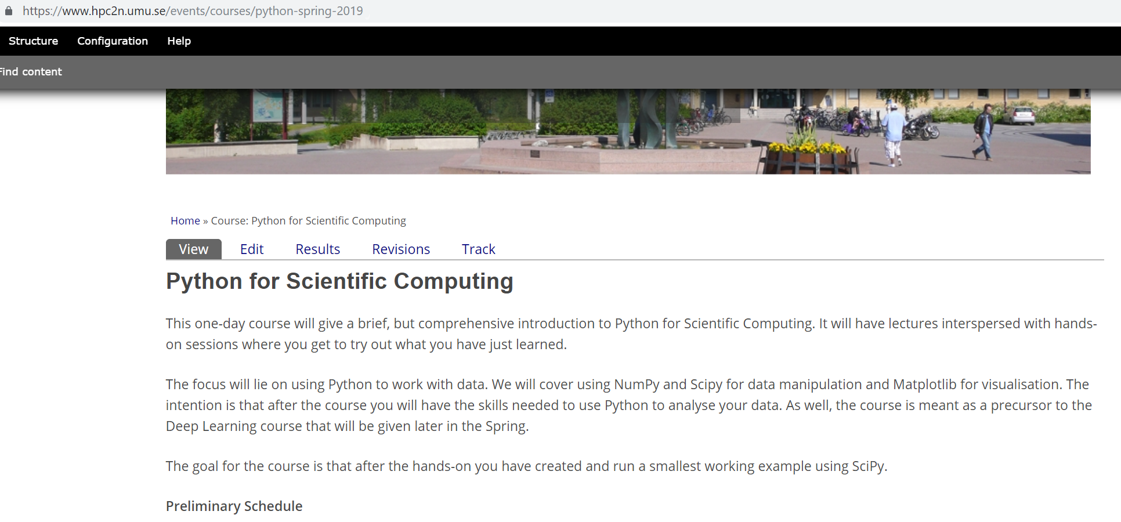
Announcements

Slide 3
x1000 core-hour/month. Source: www.snic.se

Slide 4
Data from Magnus Johnsson

Slide 5
Data from Magnus Johansson

Slide 6
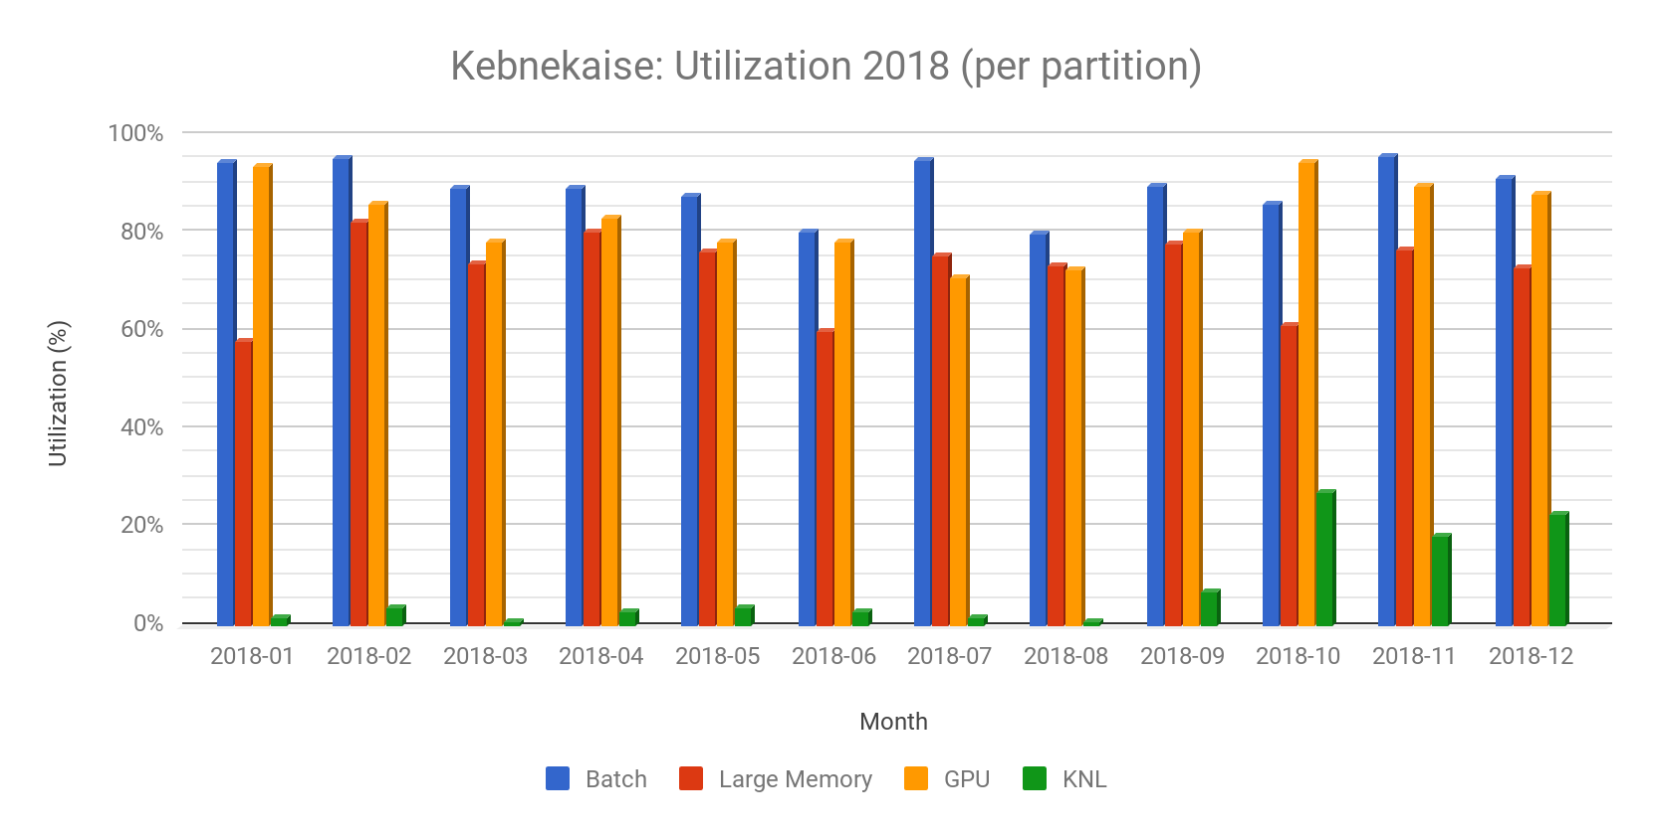
Data/plot from Björn Torkelsson

Slide 7
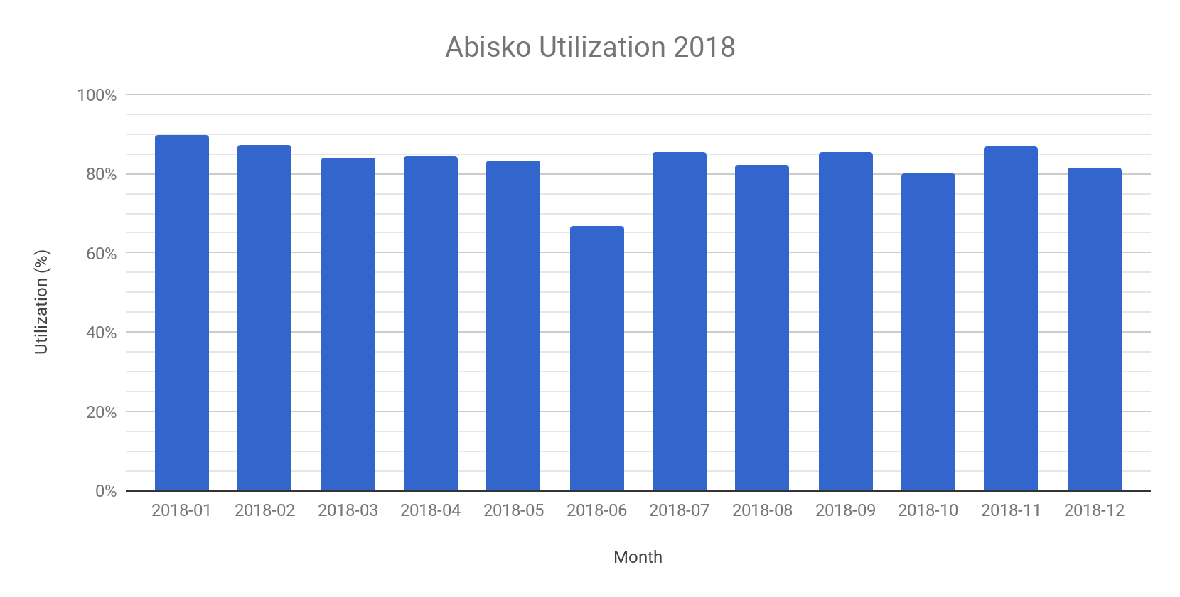
Data/plot from Björn Torkelsson

Slide 8

Processes communication
Abisko architecture
$$T_{p}=\frac{T_{s}}{P}+T_{comm}$$

Slide 9
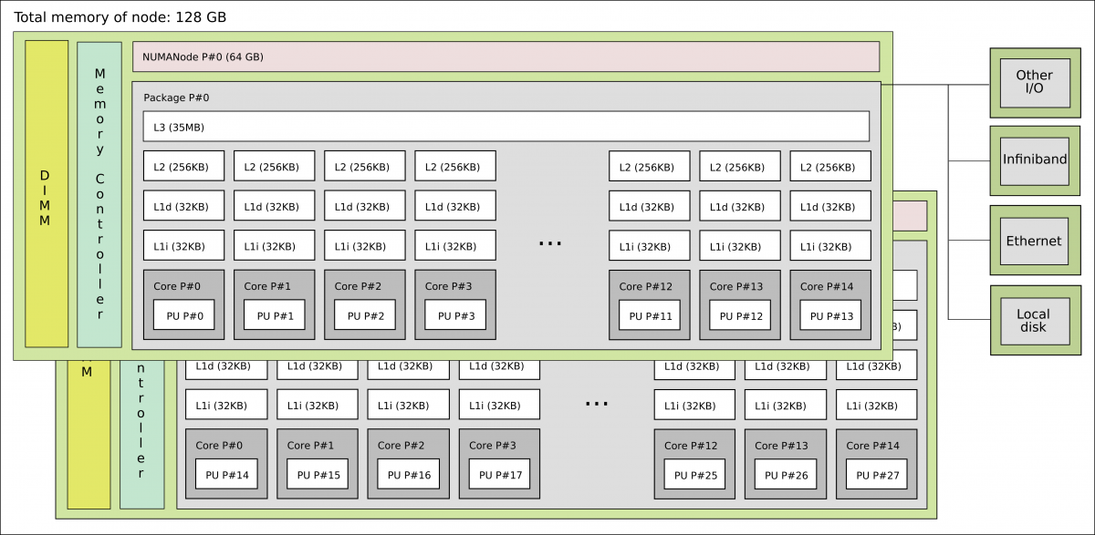
Broadwell node on Kebnekaise

Slide 10
Z(i) = A*X(i) + Y(i) (Vector Op. SIMD)

Slide 11
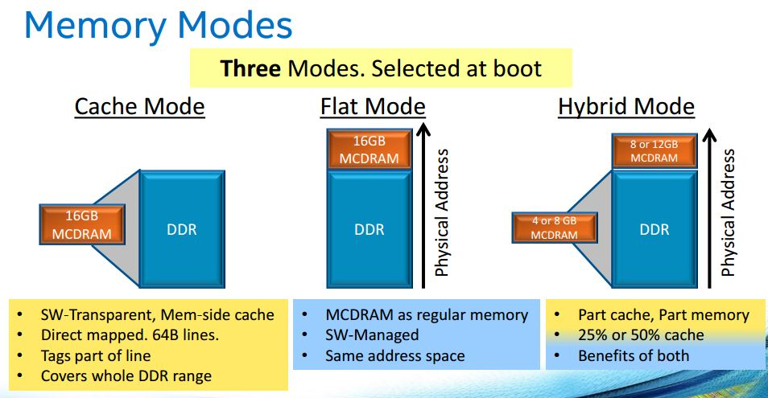
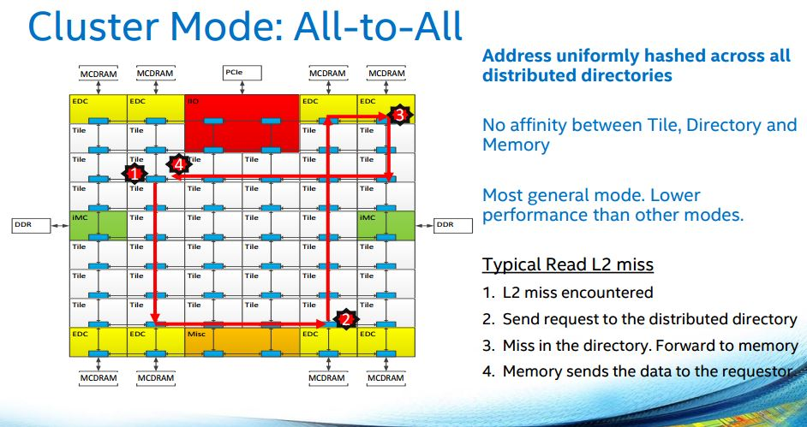
KNL
#SBATCH --constraint=a2a,cache
#SBATCH --gres=hbm:4G
Credits: PRACE Best practice KNL (2017)

Slide 12
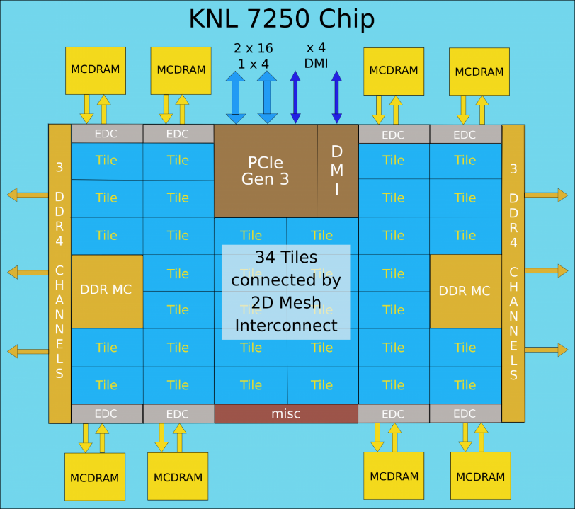
KNL Thread affinity
There are physical 68 cores with 4 hyperthreads on each.
Bind the threads by using OpenMP env. var.
export OMP_NUM_THREADS=4
export OMP_PROC_BIND=spread
export OMP_PLACES=cores
srun -n 68 -c 4 --cpu_bind=cores a_knl.out
Alternatively, use Intel var.
Credits: Intel

Slide 13
KNL Thread affinity
#export OMP_PROC_BIND=spread, close, etc.
#export OMP_PLACES=threads, cores, etc.
export OMP_NUM_THREADS=4
srun -n 16 -c 4 --cpu_bind=cores ./xthi
Hello from rank 0, thread 0, on b-cn1209.hpc2n.umu.se. (core affinity = 0)
Hello from rank 0, thread 1, on b-cn1209.hpc2n.umu.se. (core affinity = 68)
Hello from rank 0, thread 2, on b-cn1209.hpc2n.umu.se. (core affinity = 136)
Hello from rank 0, thread 3, on b-cn1209.hpc2n.umu.se. (core affinity = 204)
Hello from rank 1, thread 0, on b-cn1209.hpc2n.umu.se. (core affinity = 1)
Hello from rank 1, thread 1, on b-cn1209.hpc2n.umu.se. (core affinity = 69)
Hello from rank 1, thread 2, on b-cn1209.hpc2n.umu.se. (core affinity = 137)
Hello from rank 1, thread 3, on b-cn1209.hpc2n.umu.se. (core affinity = 205)

Slide 15
MD workload

Slide 16
MD workload

Slide 17
Data from www.scopus.com server by searching for the name of the software. In the case of AMBER the keyword dynamics was added.

Slide 18
Benchmark
Solvated protein (1AKI)
158945 atoms
1.2 nm cutoff radius
1 fs time step
PME for electrostatics
Input scripts generated in http://www.charmm-gui.org/

Slide 19
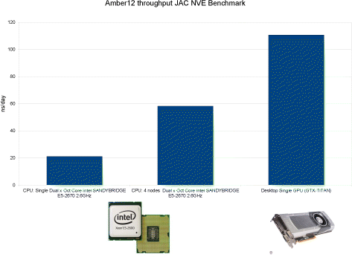
AMBER
JCTC, 9, 3878 (2013)
Models for precision:
SPSP
SPFP
SPDP
DPDP
Collection of independent routines
It uses Sander/PMEMD for solving the Newton’s equations
It offers a robust set of analysis tools
module load icc/2017.1.132-GCC-5.4.0-2.26 CUDA/8.0.44 impi/2017.1.132
module load ifort/2017.1.132-GCC-5.4.0-2.26 CUDA/8.0.44
ml Amber/16-AmberTools-16-patchlevel-20-7-hpc2n
srun pmemd.MPI -O -i input.mdin
srun pmemd.cuda.MPI -O –I input.mdin

Slide 20
AMBER Tools
For setting up a simulation (initial structure, solvation, ions, …):
Load the modules:
$ml icc/2017.4.196-GCC-6.4.0-2.28 ifort/2017.4.196-GCC-6.4.0-2.28 impi/2017.3.196
$ml Amber/16-AmberTools-17-patchlevel-8-12
On the command line:
$AMBERHOME variable
$tleap, antechamber, cpptraj, …

Slide 21
AMBER

Slide 22
AMBER-GPU
#!/bin/bash
#SBATCH -A staff
#SBATCH -t 00:50:00
#SBATCH -N 1
#SBATCH -n 4
#SBATCH --gres=gpu:k80:2
#SBATCH -p batch
#SBATCH --exclusive
#SBATCH --output=job_str.out
#SBATCH --error=job_str.err
#SBATCH --mail-type=END
ml --force purge
ml GCC/7.3.0-2.30 CUDA/9.2.88 OpenMPI/3.1.1
ml Amber/18-AmberTools-18-patchlevel-10-8
srun pmemd.cuda.MPI -O -i input.mdin -p input.parm7 -c input.rst7 -o input.mdout

Slide 23
AMBER
Notice that, the remaining CPUs are not used.
On Kebnekaise, best performance is achieved with 4 MPIs/Node and using 2 GPU cards
Nr. Ranks (-n) | Nr. GPUs | ns/day
2 | 1 | 6.36
2 | 2 | 6.34
4 | 2 | 8.55
8 (single-node) | 2 | 6.67
8 (multi-node) | 2 | 9.99

Slide 24
AMBER
If you observe any issue with a GPU run, go back to the pure CPU version (AMBER 2018 user guide)
In case you want to perform independent simulations use the variable CUDA_VISIBLE_DEVICES to specify the GPU you will use
GPU enhanced sampling: Gaussian Accelerated MD (JCTC, 11, 3584-3595, 2015)

Slide 25
NAMD
Based on charm++ communication protocol
It is object-oriented
Versions: single node, multi-node, GPU, and KNL
Highly scalable
Message driven comm.
Credits: The Int. J. Supercomp. Appl. And High Performance Comp., 10, 251-268 (1996)
Credits: JCC, 151, 283 (1999)

Slide 26
NAMD
Based on charm++ communication protocol
It is object-oriented
Versions: single node, multi-node, GPU, and KNL
Highly scalable
Message driven comm.
Credits: The Int. J. Supercomp. Appl. And High Performance Comp., 10, 251-268 (1996)

Slide 27
NAMD (SMP)
#!/bin/bash
#SBATCH -A staff
#Asking for 10 min.
#SBATCH -t 00:50:00
#Number of nodes
#SBATCH -N 1
#Ask for 28 processes
#SBATCH -c 28
#SBATCH --exclusive
#Load modules necessary for running NAMD
module add icc/2017.1.132-GCC-6.3.0-2.27 impi/2017.1.132
module add NAMD/2.12-nompi
#Execute NAMD
namd2 +p 28 +setcpuaffinity step4_equilibration.inp > output_smp.dat

Slide 28
NAMD (GPU) (single node)
#!/bin/bash
#SBATCH -A staff
#SBATCH -t 00:50:00
#SBATCH -N 1
#SBATCH -c 28
#SBATCH –exclusive
#Ask for 2 GPU cards
#SBATCH --gres=gpu:k80:2
#Load modules necessary for running NAMD
module add GCC/5.4.0-2.26 CUDA/8.0.61_375.26 OpenMPI/2.0.2
module add NAMD/2.12-nompi
#Execute NAMD
namd2 +p 28 +setcpuaffinity +idlepoll +devices $CUDA_VISIBLE_DEVICES \ step4_equilibration.inp > output_smp.dat

Slide 29
NAMD (MPI) (multiple nodes)
#!/bin/bash
#SBATCH -A SNICXXXX-Y-ZZ
#Asking for 10 min.
#SBATCH -t 00:10:00
#Number of nodes
#SBATCH -N 2
#Ask for 56 processes (2x28 cores on the nodes)
#SBATCH -n 2
#SBATCH -c 28
#SBATCH --exclusive
#Load modules necessary for running NAMD
module add GCC/6.3.0-2.27 OpenMPI/2.0.2
module add NAMD/2.12-mpi
srun namd2 +setcpuaffinity +ppn 27 config_file > output_file

Slide 30
NAMD
NAMD will scale if the number of patches >> number of processes
One can dedicate some processors to solve PME long-range part (config file)
For the CUDA version, one can offload PME to GPUs:
Colvars module for free energy calculations can be run on GPUs.
Info: Startup phase 5 took 0.00011301 s, 1131.09 MB of memory in use
Info: PATCH GRID IS 7 (PERIODIC) BY 7 (PERIODIC) BY 7 (PERIODIC)
PMEProcessors 8
Ldb unload PME yes
usePMECUDA on
PMEoffload on
In the output file you will see:
Info: PME RECIPROCAL SUM OFFLOADED TO GPU
More information:
https://www.ks.uiuc.edu/Research/namd/2.13/ug/node106.html
https://www.ks.uiuc.edu/Research/namd/wiki/?NamdPerformanceTuning

Slide 31
NAMD
Colvars module for free energy calculations can be run on GPUs
colvar {
name restrain01
width 0.5
lowerboundary 0.0
upperboundary 8.0
lowerwallconstant 100.0
upperwallconstant 100.0
distanceXY {
main { atomnumbers {list of atoms} }
ref { atomnumbers {list of atoms} }
axis (0.0, 0.0, 1.0)
}
}
Restraint where a channel is asymmetric
More information: http://www.ks.uiuc.edu/Training/Tutorials/science/channel/channel-tut.pdf

Slide 32
NAMD
Use the +setcpuaffinity flag for a 10% speedup
Github version
SMP BW
+p28 | 1.91 ns/day
SMP SKL
+p28 | 1.77 ns/day
MPI BW
-n1 +p27 | 2.09 ns/day
-n1 +p28 | 2.14 ns/day
-n2 +p14 | 0.93 ns/day
MPI SKL
-n1 +p28 | 2.06 ns/day

Slide 33
NAMD
With the new Volta GPU cards one can speed up the simulation by 1.66x
#SBATCH --constraint=skylake
#SBATCH --gres=gpu:v100:2
SMP (Skylake)
Setup | Timing (ns/day)
+p28 (2GPU) | 12.62
+p14 (1GPU) | 9.88

Slide 34
GROMACS
#SBATCH -n 4
#SBATCH -c 7
# Asking for 2 GPUs
#SBATCH --gres=gpu:k80:2
#SBATCH -p batch
ml GCC/5.4.0-2.26 OpenMPI/2.0.1 CUDA/8.0.44
ml GROMACS/2016-hybrid
if [ -n "$SLURM_CPUS_PER_TASK" ]; then
mdargs="-ntomp $SLURM_CPUS_PER_TASK"
else
mdargs="-ntomp 1"
fi
srun gmx_mpi mdrun $mdargs -npme 0 -dlb yes -v -deffnm step4.1_equilibration
GROMACS recognizes the number of available GPU cards

Slide 35
gmx tune_pme
Individual timings for input file 0 (npt_bench00.tpr):
PME ranks Gcycles ns/day PME/f Remark
0 4355.019 57.776 - OK.
0 4547.105 55.335 - OK.
0 4289.420 58.659 - OK.
-1( 0) 4455.791 56.469 - OK.
-1( 0) 4440.157 56.668 - OK.
-1( 0) 4275.551 58.850 - OK.
Tuning took 7.7 minutes.
------------------------------------------------------------
Summary of successful runs:
Line tpr PME ranks Gcycles Av. Std.dev. ns/day PME/f DD grid
0 0 0 4397.181 133.917 57.257 - 4 1 1
1 0 -1( 0) 4390.500 99.855 57.329 - 4 1 1
------------------------------------------------------------
Best performance was achieved with the automatic number of PME ranks (see line 1)
Please use this command line to launch the simulation:
mpirun -np 4 gmx_mpi mdrun -npme -1 -s npt.tpr -ntomp 7 -dlb yes

Slide 36
GROMACS

Slide 37
GROMACS

Slide 38
GROMACS KNL
#!/bin/bash
#SBATCH -A project_ID
#SBATCH -t 00:50:00
#SBATCH -N 1
#SBATCH -n 68
#SBATCH -p knl
#SBATCH --constraint=cache,quad
#SBATCH --exclusive
ml GCC/7.3.0-2.30 OpenMPI/3.1.1
ml GROMACS/2018.3
export OMP_NUM_THREADS=2
gmx mdrun -ntmpi 68 -npme 18 -ntomp 2 -pin on -pinoffset 0 -pinstride 2 -dlb auto -v -deffnm step4.1_eq

Slide 39
GROMACS KNL
Login to kebnekaise-knl.hpc2n.umu.se and submit your script from there
KNL queue is most of the time available compared to GPU one

Slide 40
GROMACS KNL
2,136,412 atoms
ts = 4fs
It uses virtual sites
cutoff radii = 1.0nm
Benchmark (2M atoms) from: https://www.mpibpc.mpg.de/grubmueller/bench

Slide 41
GROMACS KNL
Benchmark (2M atoms) from: https://www.mpibpc.mpg.de/grubmueller/bench

Slide 42
GROMACS (toolchain effects)

Slide 43
GROMACS (single node)

Slide 44
GROMACS (single node)
(-n2,-c14) srun gmx_mpi mdrun -ntomp 14 -dlb yes will use 2 GPUs
Using 2 MPI processes
Using 14 OpenMP threads per MPI process
On host b-cn1309.hpc2n.umu.se 2 GPUs auto-selected for this run.
Mapping of GPU IDs to the 2 GPU tasks in the 2 ranks on this node:
PP:0,PP:1
(-n4,-c7) srun gmx_mpi mdrun -ntomp 7 -dlb yes will use 4 GPUs
Using 4 MPI processes
Using 7 OpenMP threads per MPI process
On host b-cn1309.hpc2n.umu.se 4 GPUs auto-selected for this run.
Mapping of GPU IDs to the 4 GPU tasks in the 4 ranks on this node:
PP:0,PP:1,PP:2,PP:3

Slide 45
GROMACS (single node)

Slide 46
GROMACS (single node)
(-n4,-c7) gmx mdrun -ntmpi 4 -ntomp 7 -dlb yes will use 2 GPUs
Using 4 MPI threads
Using 7 OpenMP threads per tMPI thread
On host b-cn1105.hpc2n.umu.se 4 GPUs auto-selected for this run.
Mapping of GPU IDs to the 4 GPU tasks in the 4 ranks on this node:
PP:0,PP:1,PP:2,PP:3
PP tasks will do (non-perturbed) short-ranged and most bonded interactions on the GPU

Slide 47
GROMACS (single node-offload)

Slide 48
GROMACS (single node-offload)
(-n4,-c7) srun gmx_mpi mdrun -ntomp 7 -dlb yes will use 4 GPUs:
Using 4 MPI processes
Using 7 OpenMP threads per MPI process
On host b-cn1309.hpc2n.umu.se 4 GPUs auto-selected for this run.
Mapping of GPU IDs to the 4 GPU tasks in the 4 ranks on this node:
PP:0,PP:1,PP:2,PP:3
(-n4,-c7) gmx mdrun -gputasks 0123 -nb gpu -pme gpu -npme 1 -ntmpi 4 -dlb yes will use 4 GPUs:
Using 4 MPI threads
Using 7 OpenMP threads per tMPI thread
On host b-cn1102.hpc2n.umu.se 4 GPUs user-selected for this run.
Mapping of GPU IDs to the 4 GPU tasks in the 4 ranks on this node:
PP:0,PP:1,PP:2,PME:3
npme should be 1

Slide 49
GROMACS (multi node-offload)

Slide 50
GROMACS (multi node-offload)
(-N2,-n8,-c7) srun gmx_mpi mdrun -gputasks 0123 -nb gpu -pme gpu -npme 1 -ntomp 7 -dlb yes will use 4 GPUs:
Using 7 OpenMP threads per MPI process
On host b-cn1106.hpc2n.umu.se 4 GPUs user-selected for this run.
Mapping of GPU IDs to the 4 GPU tasks in the 4 ranks on this node:
PP:0,PP:1,PP:2,PP:3
PP tasks will do (non-perturbed) short-ranged interactions on the GPU
PME tasks will do all aspects on the GPU
There are some limitations regarding the tasks that can be offloaded, please check:
http://manual.gromacs.org/current/user-guide/mdrun-performance.html

Slide 51
GROMACS
PLUMED, threaded MPI version is not supported.
Instead of:
gmx mdrun –ntmpi X
Use:
mpirun gmx_mpi …

Slide 52
LAMMPS (MPI)
#!/bin/bash
#SBATCH -A staff
#Asking for 10 min.
#SBATCH -t 02:10:00
#Number of nodes
#SBATCH -N 1
#Ask for 28 processes
#SBATCH -n 28
#SBATCH --exclusive
#Load modules necessary for running LAMMPS
module load icc/2017.1.132-GCC-6.3.0-2.27 ifort/2017.1.132-GCC-6.3.0-2.27 impi/2017.1.132
module load LAMMPS/31Mar17
#Execute LAMMPS
srun lmp_intel_cpu -in step4.1_equilibration.inp

Slide 53
LAMMPS (OpenMP)
#!/bin/bash
#SBATCH -A staff
#Asking for 10 min.
#SBATCH -t 02:10:00
#Number of nodes
#SBATCH -N 1
#Ask for 28 processes
#SBATCH -n 14
#SBATCH -c 2
#SBATCH --exclusive
#Load modules necessary for running LAMMPS
module load icc/2017.1.132-GCC-6.3.0-2.27 ifort/2017.1.132-GCC-6.3.0-2.27 impi/2017.1.132
module load LAMMPS/31Mar17
export OMP_NUM_THREADS=2
#Execute LAMMPS
srun lmp_intel_cpu -in step4.1_equilibration.inp
~3x slower than MPI only version

Slide 54
LAMMPS - OpenMM - CHARMM

Slide 55
Scratch directory
If the program writes frequently data, you can get an additional speed up by using the local scratch directory:
rm -rf /scratch/test
export parent=/pfs/nobackup/home/u/username/benchmarks/
mkdir /scratch/test
rsync -avzh $parent/ /scratch/test/
cd /scratch/test
namd2 +p 28 +setcpuaffinity input.inp > output.dat
cd $parent
rsync -avzh /scratch/test/ $parent/
rm -rf /scratch/test
~10-15% speedup
Abisko (all nodes): 352 GB
Kebnekaise, standard nodes: 171 GB
Kebnekaise, GPU nodes: 171 GB
Kebnekaise, Largemem nodes: 352 GB (a few of them have 391 GB)

Slide 56
Plugins/Tools
Note: not all the tools referenced here are installed on our systems. It is indicated with the labels: I=installed, MI=manually installed

Slide 57
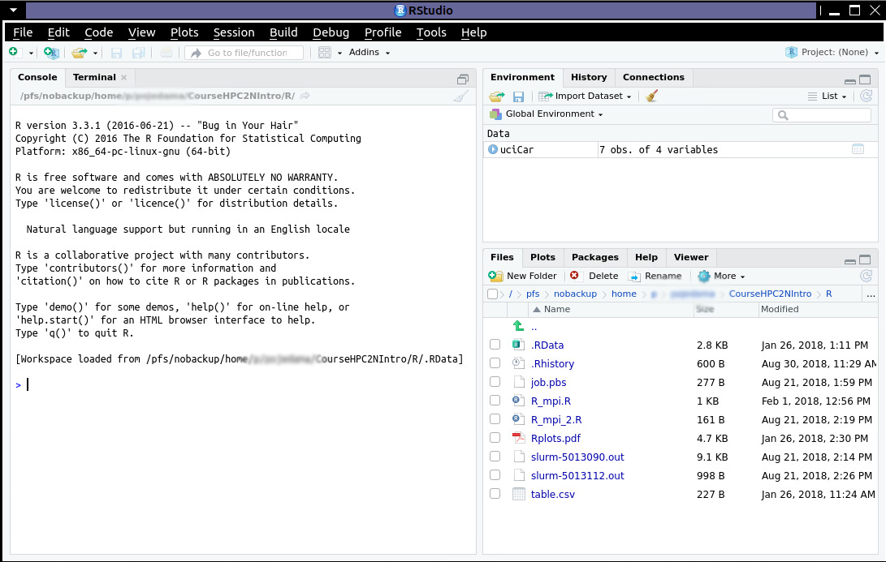
R/Rstudio (I)
$ml icc/2017.1.132-GCC-6.3.0-2.27 impi/2017.1.132 ifort/2017.1.132-GCC-6.3.0-2.27
$ml R/3.3.1
$rstudio

Slide 58
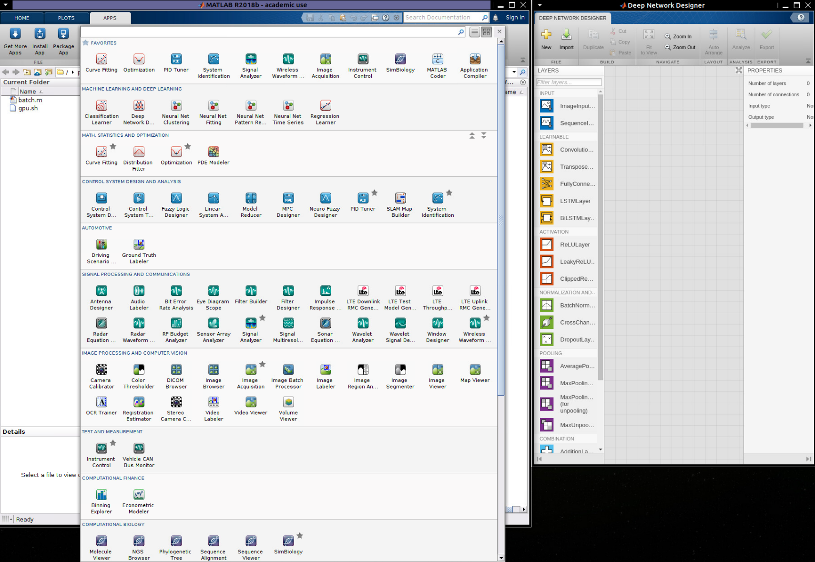
MATLAB (I)
$ml MATLAB/2018b
Includes improved tools for Machine Learning and Deep Learning
PRL, 120, 143001 (2018)
Further information: https://www.hpc2n.umu.se/resources/software/matlab

Slide 59
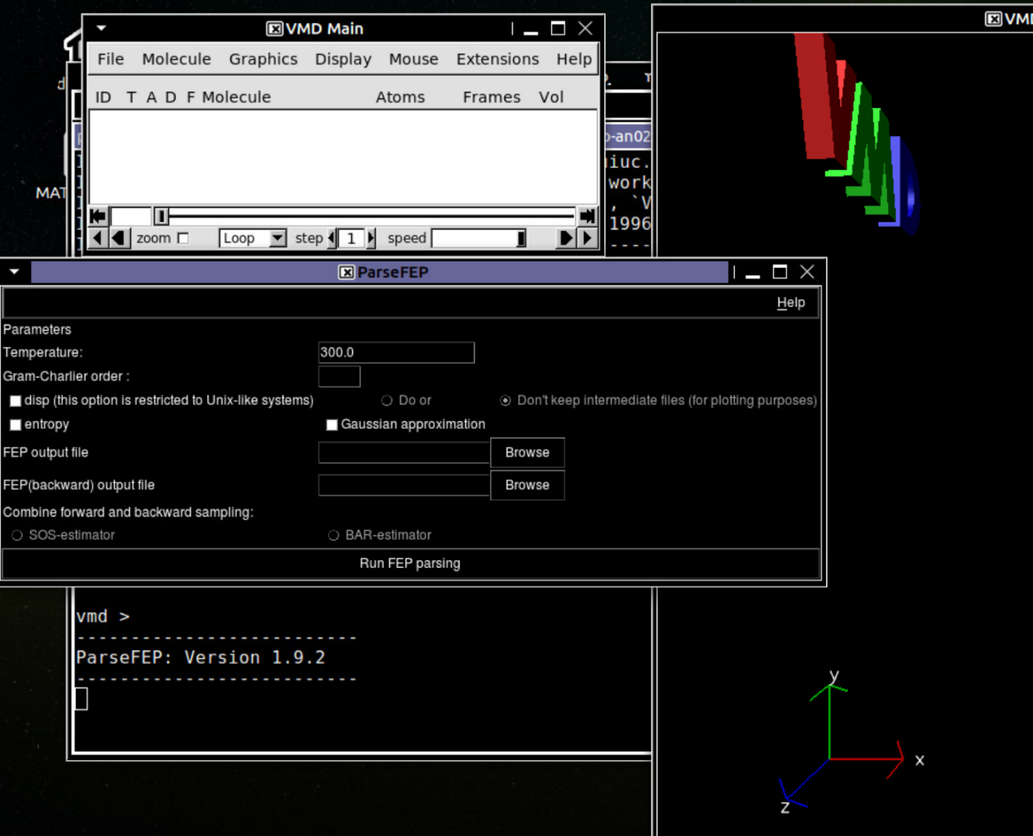
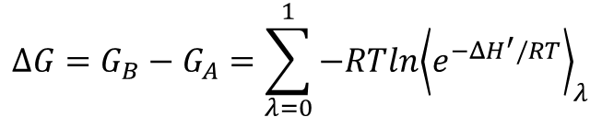

Alchemical simulations (I)
$$H\left(λ\right)=λH_{B}+(1−λ)H_{A}$$
$$ΔG=G_{B}−G_{A}=\sum_{λ=0}^{1}{−RTln{\left\langle e^{−ΔH^{′}/RT}\right\rangle }_{λ}}$$
Chem. Rev., 93, 2395-1417 (1993)
Dual topology. Figure taken from: http://www.ks.uiuc.edu/Training/Tutorials/namd/FEP/tutorial-FEP.pdf
parseFEP in VMD software

Slide 60
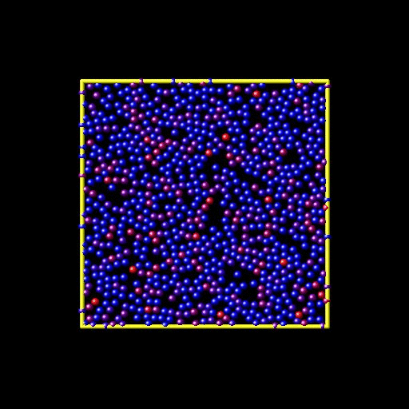
NEMD-2D (I)
Simulation performed using LAMMPS
More information:
https://github.com/lammps/lammps/tree/master/examples/VISCOSITY
Similar NEMD simulations can be performed with GROMACS: Mol. Sim., 36, 560-567 (2010).
pair_style lj/cut ${rc}
# shear rate defined relative to perpendicular dimension
variable xyrate equal ${srate}/ly
fix 1 all nvt/sllod temp $t $t 0.1
fix 2 all deform 1 xy erate ${xyrate} remap v

Slide 61
QM/MM simulations
CHARMM SQM (MI)
!Topology and coordinates files
!Define the QM region
define subs sele segid mnp show end
!Specify the QM method
mndo remo sele subs show end -
GLNK sele none show end amd char -3 -
switched DXLBomd NORD 9 NSTEpSCF 7
!Perform the dynamics
dynamics cpt leap restart time 0.0005 nstep 40000 …
Adapted from Methods in Mol. Biology, vol. 924. G. Groenhof.

Slide 62
QM/MM simulations
CHARMM SQM (MI)
!Topology and coordinates files
!Define the QM region
define subs sele segid mnp show end
!Specify the QM method
mndo remo sele subs show end -
GLNK sele none show end amd char -3 -
switched DXLBomd NORD 9 NSTEpSCF 7
!Perform the dynamics
dynamics cpt leap restart time 0.0005 nstep 40000 …
Adapted from Methods in Mol. Biology, vol. 924. G. Groenhof.

Slide 63
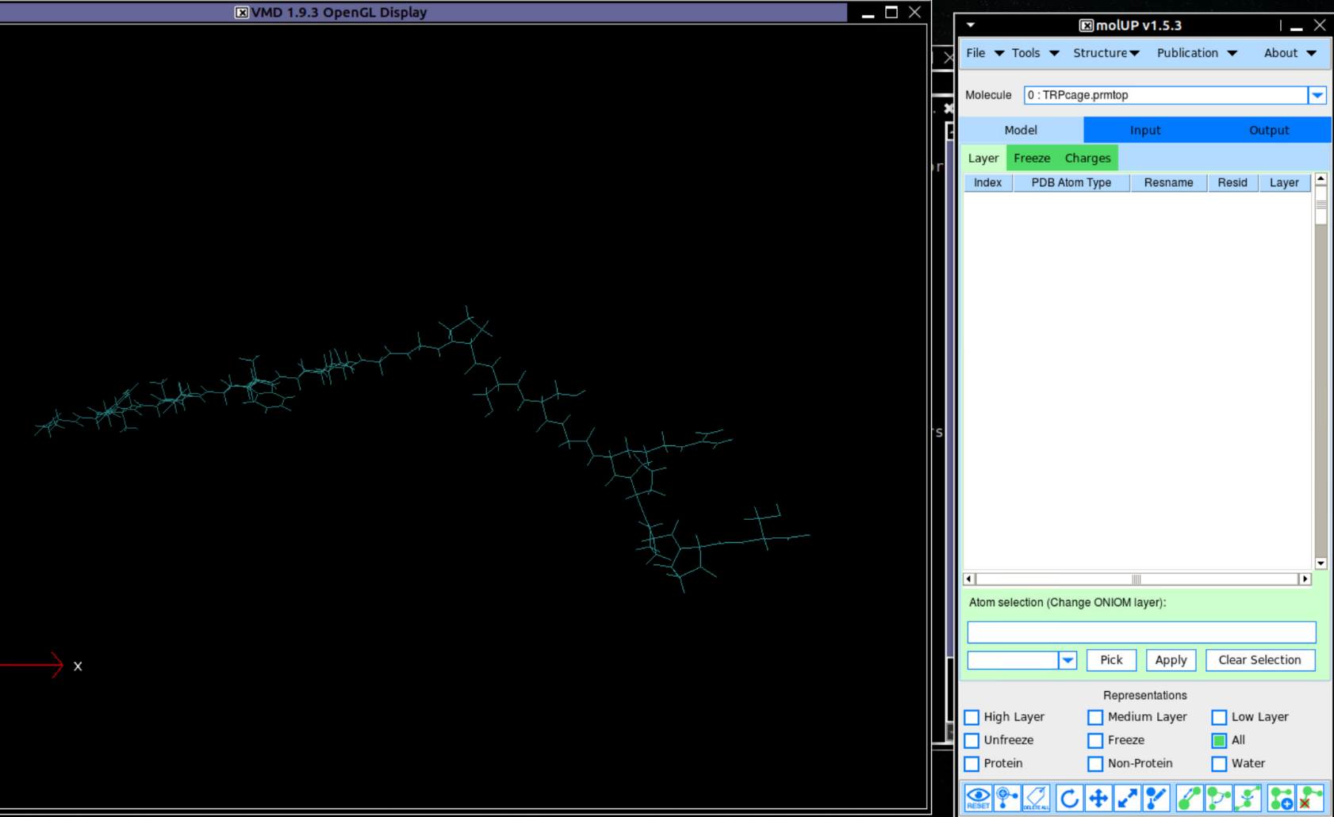
QM/MM simulations
CHARMM SQM
molUP, (Amber, JCC, 39, 1344-1353, 2018) (MI)
molUP plugin for QM/MM simulations in VMD

Slide 64
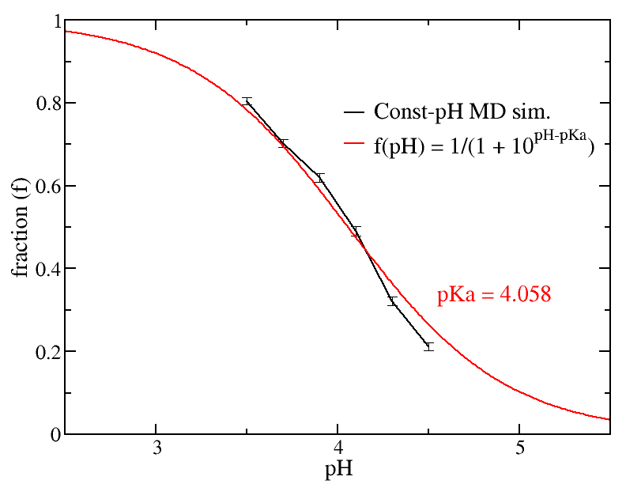
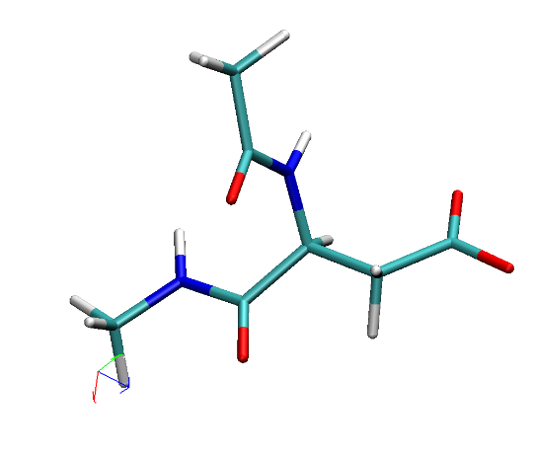
Constant pH simulation (I)
source ../../lib/namdcph/namdcph.tcl
…
parameters $toppar_dir/par_all36_solvent.prm
# Load constant-pH specific topology files
cphConfigFile $toppar_dir/conf_cph36_prot.json
topology $toppar_dir/top_cph36_prot.rtf
# We will be running multiple pH values sorted into their own directories, but
# otherwise using the same naming scheme.
set pH 3.5
pH $pH
outputname $pH/ace_asp_nme_prod0
cphMDBasename $pH/namdcph.md
cphSwitchBasename $pH/namdcph.sw
# With the current settings this implies 1 ps between switching attempts,
# which will be 15 ps in length.
#
cphNumstepsPerSwitch 7500
cphRun 500 5
NAMD config file taken from: http://www.ks.uiuc.edu/Training/Tutorials/
Method described in: JCTC, 13, 5933-5944 (2017)
http://ambermd.org/tutorials/

Slide 65
Constant pH simulation (I)
Recent progress in this field, Cruzeiro et. al, JCP, 149, 072338 (2018), Redox potential replica exchange molecular dynamics at constant pH in AMBER: Implementation and validation

Slide 66
Analysis
StreaMD: Advanced analysis of molecular dynamics using R, JCC, 39, 1666 (2018). (MI)
http://thegrantlab.org/bio3d/tutorials/normal-mode-analysis (MI)
http://www.ks.uiuc.edu/Training/Tutorials/
https://github.com/rjdkmr/do_x3dna DNA structural analysis (GROMACS) (MI)

Slide 67
Suggestions
Check if the software version you are trying is MPI (-n), OpenMP (-c), or hybrid (-n -c). Also, if you are using a GPU version.
Is the cutoff radius for long-range interactions appropriate? PME?
Could KNL nodes speed up your workflow?
Upon asking a question to the support team: Make a folder with the case which displays the issue. Including all relevant files would be useful.
Don’t forget to cite HPC2N and SNIC when publishing.

Slide 68
Terminology
BW: Broadwell nodes
SK: Skylake nodes
KNL: Knights Landing nodes

