Slide 1
Basic procedure for MD simulations
Yaozong Li
Nov. 20, 2017

Slide 2
Protein preparation
1
Solvating the system
Ionizing
2
Minimization
3
MD simulation
4

Slide 3
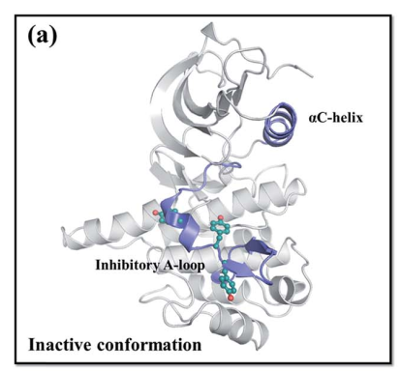
1. Protein preparation
Download original PDB file (1p4o, chain A)
Extract the target structure
Fix the structure (check the sequence, add hydrogen, regulate side chains of protein residues, make up the missing parts)
IGF-1RK
Apo
(PyMoL Show)
Chem. Sci., 2017, 8, 3453–3464

Slide 4
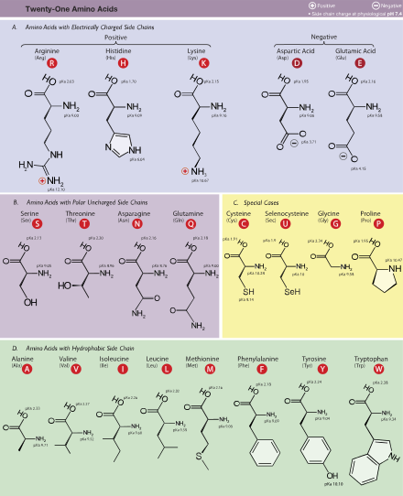
Protonation states
rotation

Slide 5
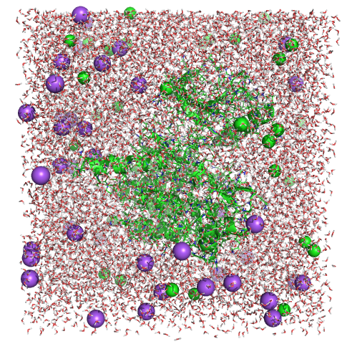
2. Solvating and ionizing the system
(PyMoL Show)

Slide 6
3 & 4. Minimization & MD simulation
Configuration file:
Structure (psf)
Coordinates (PDB)
Parameters
Interactions (vdW & electrostatic)
Temperature & pressure control
Periodic boundary conditions

Slide 7
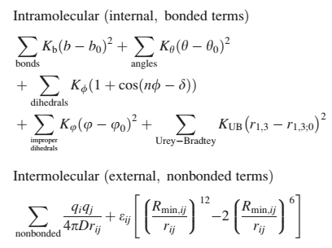
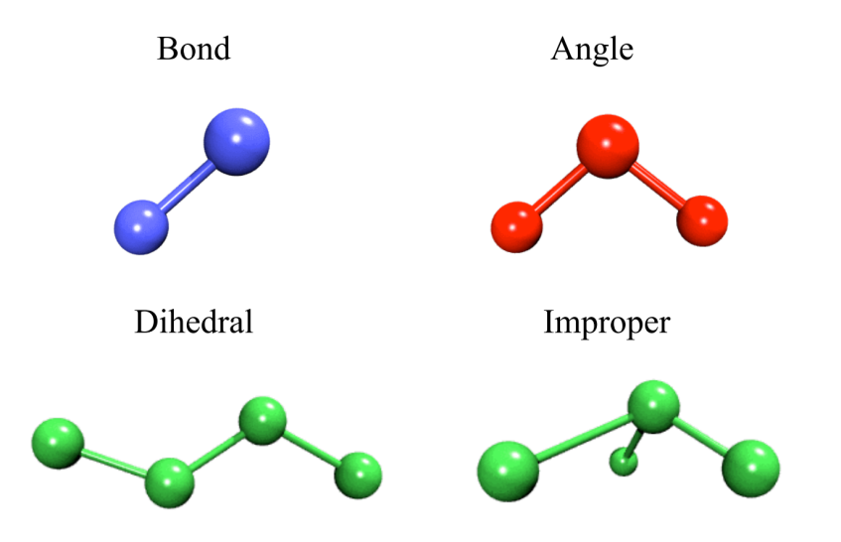
5. Parameterization of small molecules
An easy way: search parameter databases (e.g., https://cgenff.paramchem.org/)

Slide 8
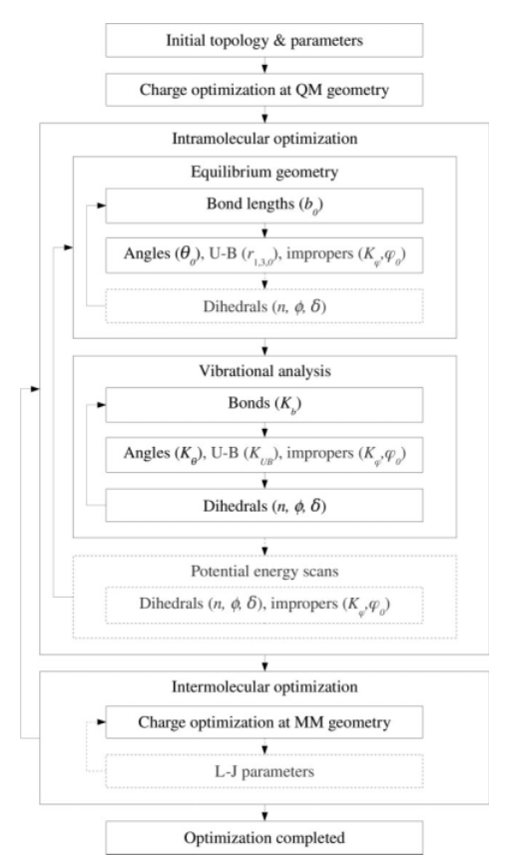
Example
J Comput Chem. 2010 Mar;31(4):671-90.

